Slide 1
Risk and Return and Stock Valuation

Slide 2



Power of Diversification
Asset A
Economic Scenario | Probability (P) | Holding Return (HR) | Expected Return (ER) | HR−ER | (HR−ER)² | P(HR−ER)²
Down | .2 | −20 % | −4.0 % | −38.5 % | 1,482.25 | 296.45
Steady | .5 | 15 % | 7.5 % | -3.5 % | 12.25 | 6.13
Up | .3 | 50 % | 15.0 % | 31.5 % | 992.25 | 297.68
 |  |  | ER = 18.5 % |  |  | Var = 600.26
 |  |  |  |  |  | SD = 24.50
Asset B
Economic Scenario | Probability (P) | Holding Return (HR) | Expected Return (ER) | HR−ER | (HR−ER)² | P(HR−ER)²
Down | .2 | 50 % | 10.0 % | 38.5 % | 1,482.25 | 296.45
Steady | .5 | 15 % | 7.5 % | 3.5 % | 12.25 | 6.13
Up | .3 | −20 % | −6.0 % | −31.5 % | 992.25 | 297.68
 |  |  | ER = 11.5 % |  |  | Var = 600.26
 |  |  |  |  |  | SD = 24.50
Portfolio – 50 % of Asset A + 50 % of Asset B
Economic Scenario | Probability (P) | Holding Return (HR) | Expected Return (ER) | HR-ER | (HR−ER)² | P(HR−ER)²
Down | .2 | 15% | 3.0% | - | - | -
Steady | .5 | 15% | 7.5% | - | - | -
Up | .3 | 15% | 4.5% | - | - | -
 |  |  | ER = 15.0% |  |  | Var = 0.0
 |  |  |  |  |  | SD = 0.0

Slide 3
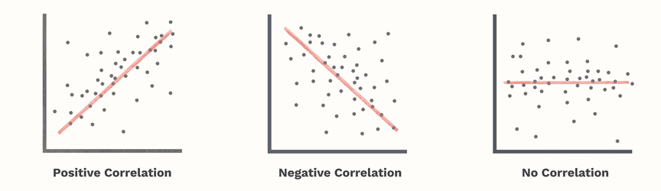
Power of Diversification

Slide 4
Power of Diversification
Asset Class | U.S. Large Cap Growth | U.S. Large Cap Value | U.S. Mid Cap Growth | U.S. Mid Cap Value | U.S. Small Cap Growth | U.S. Small Cap Value | International Stocks
U.S. Large Cap Growth | 1.000 | 0.848 | 0.896 | 0.740 | 0.856 | 0.718 | 0.582
Asset Class | Emerging Markets Stocks | U.S. Investment Grade Bonds | U.S. High Yield Bonds | Non-U.S. Bonds | Cash | Commodities | Real Estate
U.S. Large Cap Growth | 0.517 | 0.189 | 0.528 | 0.005 | 0.023 | 0.1264 | 0.444

Slide 5
Diversifiable and Non-Diversifiable Risk
Diversifiable risk

Slide 6
Calculating Beta

Slide 7
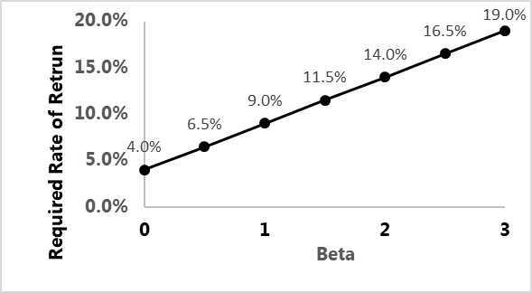
Capital Asset Pricing Model (CAPM)
k_{a} = k_{f} + B_{a} (k_{m} – k_{f})
k_{a} = RRR for Investment A
k_{f} = Risk-free rate
B_{a} = Beta for Investment A
k_{m} = Market rate
k_{m} – k_{f} = Market risk premium

Slide 8
Holding Return Components
Equity holding returns come from two sources:
Dividend yield
Capital gains yield
Mature companies get most of their return from the dividend yield
Growth companies get most of their return from the capital gains yield

Slide 9
Income Approach
Dividend Discount Model
One-Stage
Two-Stage
Multiple-Stage

Slide 10
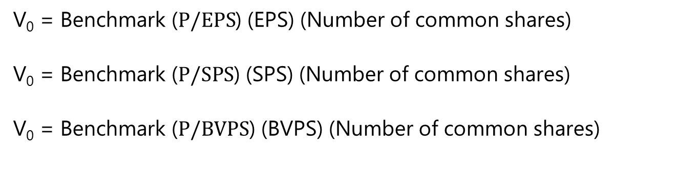
Market Multiples Approach
V₀ = Benchmark ($P/EPS$) (EPS) (Number of common shares)
V₀ = Benchmark ($P/SPS$) (SPS) (Number of common shares)
V₀ = Benchmark ($P/BVPS$) (BVPS) (Number of common shares)
Benchmark Multiple
Comparable companies
Historical average multiples
Estimating Future EPS
Trailing EPS
Leading EPS

Slide 11
Raising Equity Capital
New Venture Financing
Self-funding
Crowdfunding
Angels, incubators, accelerators
Venture capital
Private Placement
Going Public
Public Placement
Secondary Market
Stock exchanges and specialists
Electronic trading
Dealer market
ATS and ECN
Seed financing | Researching a new business concept
First stage | Concept development
Second stage | Developing a prototype
Third stage | Production of a product or service
Fourth stage | Rapid expansion

Slide 12
Common and Preferred Shares
Common Shares
Receive all residual profits of the business
Not obligated to pay dividends if funds are needed
Vote in board elections and major decisions
Preemptive rights
Assign a proxy to the management or shareholder group
Multiple share classes with different voting rights – non-voting, restricted, or subordinate voting
Preferred Shares
No voting rights, so there is no potential loss of control
No dilution of EPS
Preference over common shareholders if the company is liquidated
Fixed dividends, adjustable or floating rate dividends based on a benchmark rate, or participating dividends
Ability to delay the payment of dividends indefinitely
Call, conversion, and redemption features
Term features that require regular sinking or purchase fund payments

Slide 13
Preferred Shares and Debt
Similarities Between Preferred
No voting rights
Fixed or adjustable rate dividend that is usually always paid
Conversion, redemption, and call features
Limited terms with sinking or purchase fund requirements
Preference over common shareholders in liquidation
Preferred share ratings provided by the same bond rating services
Choice Between Preferred Shares and Debt
Excessive amounts of operating and financial leverage and cyclical cash flows make paying fixed debt obligations in a recession difficult

Slide 14
Efficient Market Hypothesis (EMH)
Forms of EMH
Strong form efficiency
Semi-strong form efficiency
Weak form efficiency
Lessons
Markets demonstrate semi-strong form efficiency
Difficult to earn abnormal returns over the security market line
Passive investment management generates higher returns than active management after management expenses and taxes
Focus on reducing management expense ratios by following an indexing strategy and practicing tax-efficient investing
Avoid technical analysis or charting, as it is based on past information only

