Slide 1
Permanent Debt and Equity Financing

Slide 2
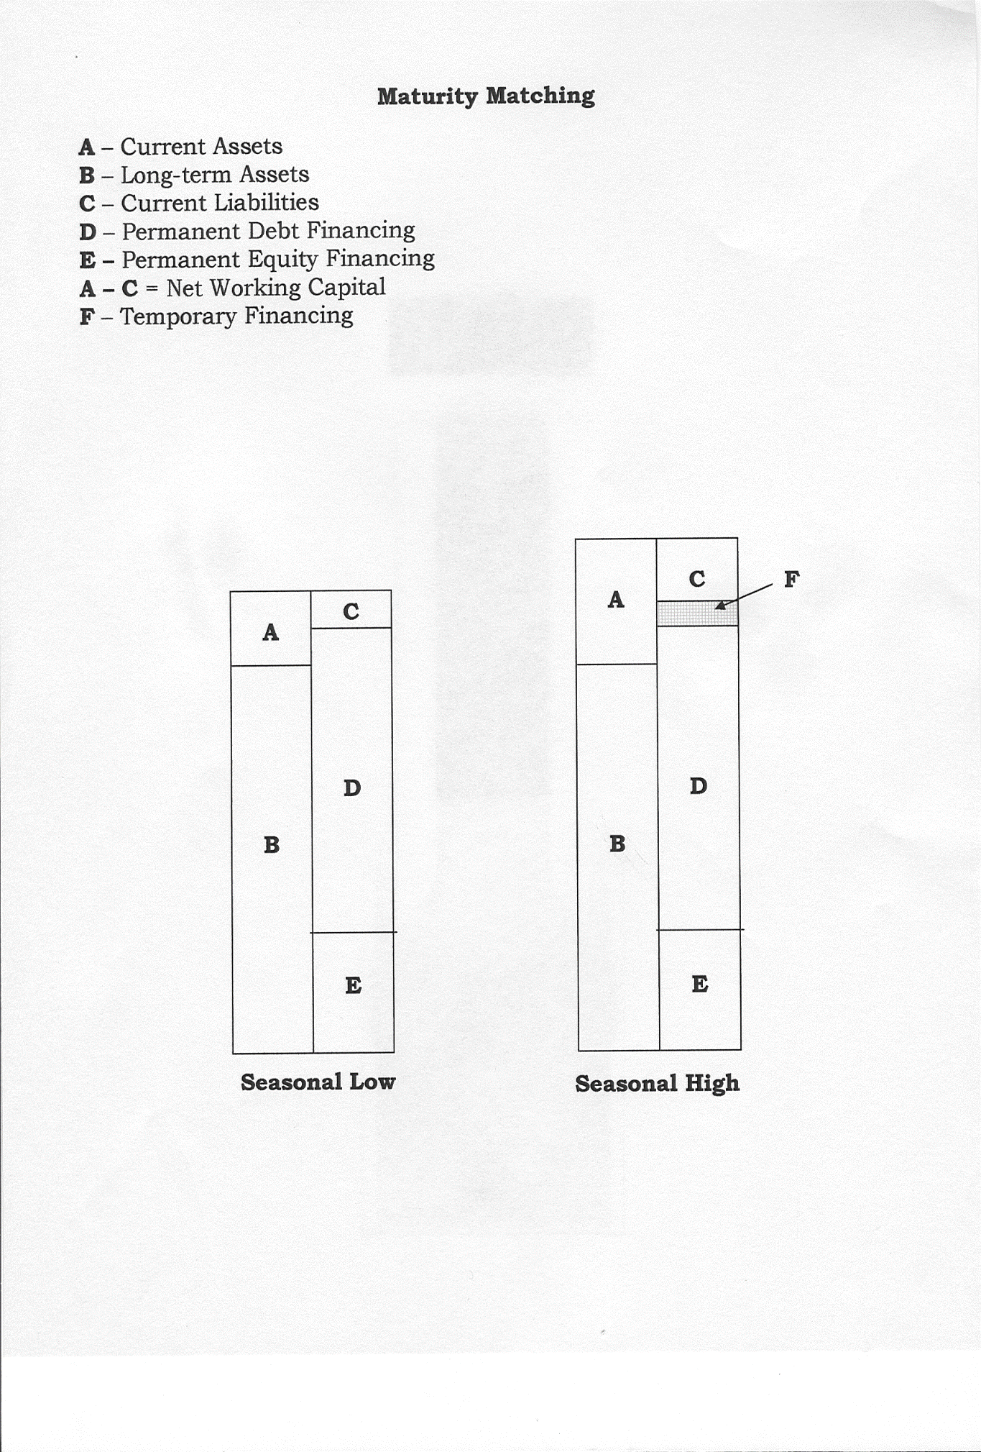
Maturity Matching Concept
A – Current assets
B – Long-term assets
C – Current liabilities
D – Permanent debt financing
E – Permanent equity financing
A minus C = Net working capital
F – Temporary financing

Slide 3
Sources of Permanent Financing
Debt
Commercial mortgage loans
Term loans
Syndicated loans
Mezzanine financing
Bridge loans
Project financing
Securitization
Leases
Bonds, notes, debentures
Government Financing Programs
Business Development Bank of Canada (BDC)
Export Development Corporation (EDC)
Canadian Small Business Financing Loan (CSBFL)
Equity
Self-funding
Crowdfunding
Private equity
Angels, incubators, accelerators
Venture capital
Franchising
Retained earnings
Preferred and common shares
Dividend re-investment plans
Rights offerings
Warrants, stock options
Limited partnerships
Joint ventures and strategic alliances
Employee stock ownership plans (ESOPs)
Private Placements
Public Placements

Slide 4
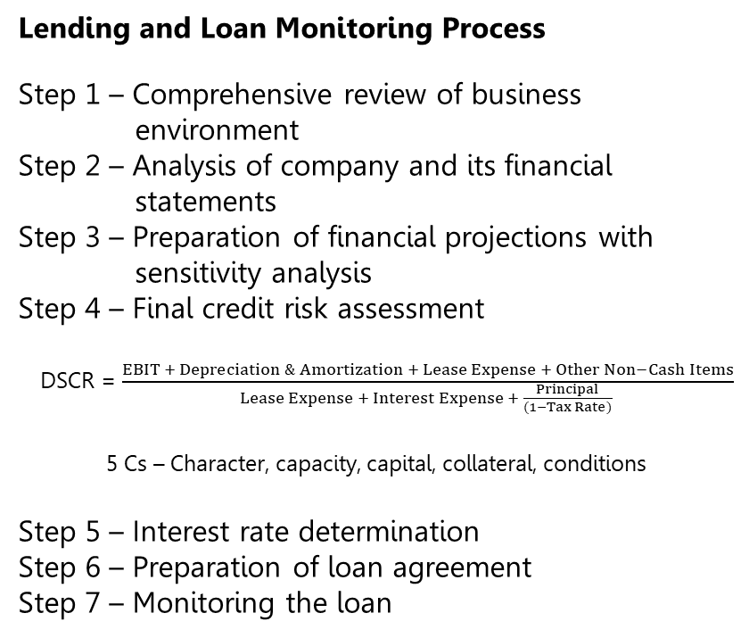
Commercial Lending
Sources of Commercial Lending
  Chartered banks
  Credit unions
  Institutional lenders
  Life insurance companies
  Pension funds
  Trust companies
Types of Lending
  Asset-Based
  Cash-Flow Based
Lending and Loan Monitoring Process
Step 1 – Comprehensive review of business environment
Step 2 – Analysis of company and its financial statements
Step 3 – Preparation of financial projections with sensitivity analysis
Step 4 – Final credit risk assessment
DSCR = $\frac{EBIT + Depreciation \& Amortization + Lease Expense + Other Non−Cash Items}{Lease Expense + Interest Expense + \frac{Principal}{(1−Tax Rate)} }$
5 Cs – Character, capacity, capital, collateral, conditions
Step 5 – Interest rate determination
Step 6 – Preparation of loan agreement
Step 7 – Monitoring the loan

Slide 5
Leasing
Pros and Cons of Leasing
Financing flexibility
Operational flexibility
Lessor expertise
Lending restrictions
Tax savings
Cost
Real estate
Contractual disputes
Operating Versus Financial Leases
Accounting for Leases
Total asset turnover ratio
Debt-to-total-assets ratio
Rate of return on assets
Capitalizing Leases
All leases are capitalized unless they are less than 12 months or of low value
Assets and liabilities are equal to the present value of future lease payments
Discount rate used is the implicit rate in the lease or the incremental borrowing rate if that is not available

Slide 6
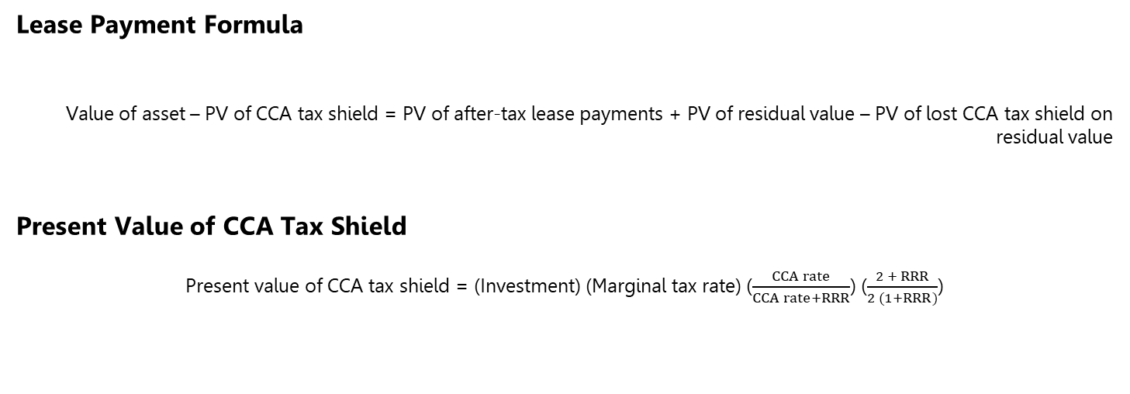
Calculating Lease Payments
Lease Payment Formula
Value of asset – PV of CCA tax shield = PV of after-tax lease payments + PV of residual value – PV of lost CCA tax shield on residual value
Present Value of CCA Tax Shield
Present value of CCA tax shield = (Investment) (Marginal tax rate) ($\frac{CCA rate}{CCA rate+RRR}$) ($\frac{2 + RRR}{2 (1+RRR)}$)

Slide 7
Lease or Buy?
Companies should do a comparison of leasing versus buying an asset to determine which form of financing is the most affordable
A differential analysis that is very similar to the process followed in capital budgeting is used
Tax Law for Specified Leasing Property
A lessor of exempt assets can deduct full CCA, but a lessor of non-exempt assets is limited to the lower of:
CCA
Principal a lessor receives if a lease is treated as a loan is equal to the fair value of the leased asset, discounted at the prescribed rate
Lessee can elect to be treated as the owner of a non-exempt asset for tax purposes, allowing them to deduct both interest and CCA
These rules begin to harmonize the accounting treatment for leases under the ITA and IFRS

Slide 8
Corporate Bond Financing
Bonds Versus Commercial Loans
Why bonds?
Lower interest costs by borrowing directly
More liquid investment further lowers interest rates
Fewer lending covenants and less rigorous monitoring
Longer-term financing
Why commercial loans?
Can be arranged quickly
Accessible to small lenders due to lower issuance costs
Customized repayment is more possible
Agreements can be more easily modified
No expensive bond ratings
No public disclosures of company information
Bond Features
Covenants
Callable bonds
Convertible bonds
Bond sinking funds
Credit ratings
Collateral
Subordination
Guarantees

Slide 9
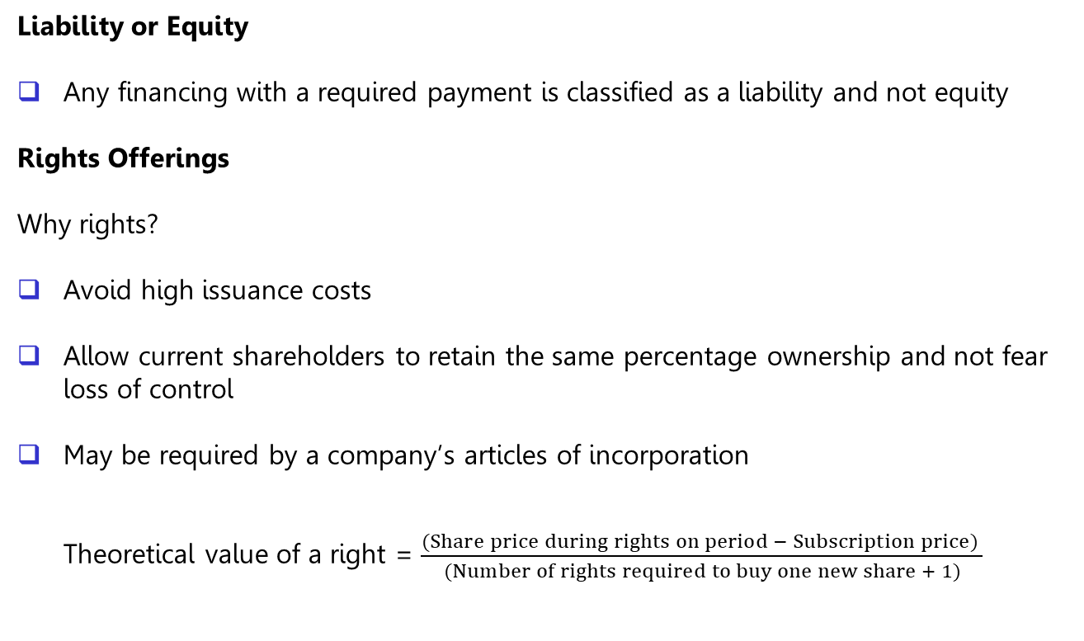
Equity Financing
Liability or Equity
Any financing with a required payment is classified as a liability and not equity
Rights Offerings
Why rights?
Avoid high issuance costs
Allow current shareholders to retain the same percentage ownership and not fear loss of control
May be required by a company’s articles of incorporation
Theoretical value of a right = $\frac{(Share price during rights on period − Subscription price) }{(Number of rights required to buy one new share + 1)}$

