Slide 1
Hedging Financial Risk Using Derivatives

Slide 2
Business Risks
Categories of Business Risk
Strategic risks
Operational risks
Hazard risks
Financial risks
Exchange rates
Interest rates
Commodity prices
Enterprise Risk Management (ERM)
Types of Business Insurance
Property
Liability
Workers’ compensation
Vehicle
Key person
Business interruption
Export

Slide 3
Exchange Rates
Direct and Indirect Quotes
CAD/USD 1.2486 USD/CAD 0.8009
Spot and Forward Rates
Bid-Ask Quotations
Cross Rates

Slide 4
Hedging Exchange Rate Risk
Forward contracts
Swap contracts
Options contracts
Natural hedge or cash flow matching

Slide 5
Hedging Interest Rate Risk
Interest Rate Swaps
Fixed-for-floating
Floating-for-fixed
Fixed-for-Floating
Floors, Caps, and Collars
Payer | Fixed Leg Paid | Float Leg Received | Net Swap Payment | Interest Payment | Net Interest Payment
Year 1 | (30,550) | 29,500 | (1,050) | (29,500) | (30,550)
Year 2 | (30,550) | 32,750 | 2,200 | (32,750) | (30,550)
Receiver | Float Leg Paid | Fixed Leg Received | Net Swap Payment | Interest Payment | Net Interest Payment
Year 1 | (29,500) | 30,550 | 1,050 | (30,550) | (29,500)
Year 2 | (32,750) | 30,550 | (2,200) | (30,550) | (32,750)

Slide 6
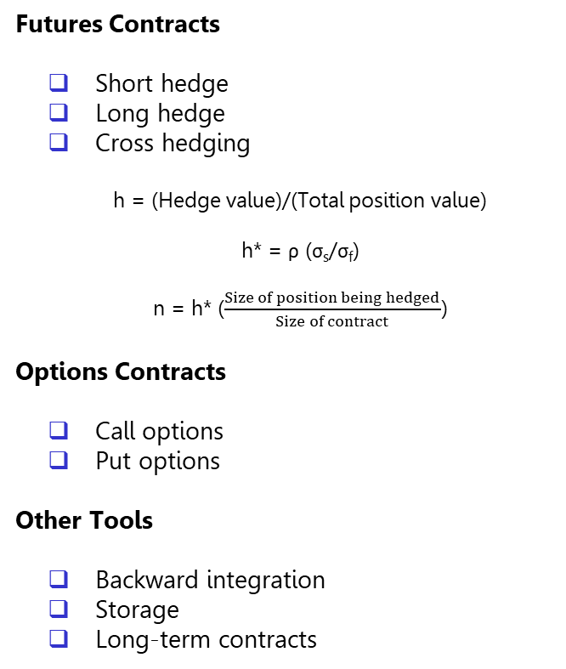
Hedging Commodity Price Risk
Types of Futures Contracts
Agricultural
Energy
Metal
Financial
Futures Versus Forwards
Standardized contracts designed by an exchange
Trade publicly on an organized exchange
Daily price data available
Exchange acts as a clearinghouse
Initial and maintenance margins required
Daily settlement
Physical delivery is rarely taken
Hedging Tools
Futures Contracts
Short hedge
Long hedge
Cross hedging
h = (Hedge value)/(Total position value)
h* = ρ (σ_{s}/σ_{f})
n = h* ($\frac{Size of position being hedged}{Size of contract}$)
Options Contracts
Call options
Put options
Other Tools
Backward integration
Storage
Long-term contracts
 | Futures | Options
Buying the commodity Expect a price increase | Long futures contract | Purchase a call option
Selling the commodity Expect a price decrease | Short futures contract | Purchase a put option

