Slide 1
Financial Reporting Quality

Slide 2
Limitations of Financial Reporting
“What is your net income?” “What do you want it to be?”
Considerable discretion allows companies to manipulate their financial performance. Why?
1. Accounting policies and estimates
  FIFO, average cost, specific identification
  Straight-line, accelerated depreciation
  Useful life, bad debts expense
2. Valuation of assets, liabilities, and equities
  Historical cost versus fair value
  Assets may be excluded if developed internally
  Off-balance sheet assets and liabilities
3. Classification of assets and liabilities
  Long-term versus current assets or liabilities
  Liability versus equity
4. Poor quality of earnings
  Revenue recognition
  Cost recognition
  Timing of discretionary expenses, asset revaluations, impairment losses and reversals
  Classifying revenues and expenses as operating or non-operating

Slide 3
Earnings Quality
Definition of earnings quality
  Aggressive practices
  Conservation practices
Earnings quality dilemma
Maximize management compensation
Attract new managers
Cheaper take-overs using stock swaps
Meet loan requirements
Avoid the scrutiny of the board of directors and stock markets
Earnings management
Inflating and “smoothing” earnings
Revenue recognition strategies
Cost recognition strategies
Classification strategies
Warning signs or “red flags” of earnings management
Smooth
EPS
Inflate
Time

Slide 4
Consolidated Income Statement
Sales 817,000
Cost of sales 450,000
Gross profit 367,000
Operating expenses
Selling, general, and administration 120,000
Research and development 75,000 195,000
Operating income from continuing operations 172,000
Other revenue and gains
Financing income 15,000
Income from associates & joint ventures 10,000
Gain on disposal of securities 8,000 33,000
Other expenses and losses
Financing expense 17,000
Restructuring charges 8,000
Income from continuing operations before taxes 180,000
Income taxes 72,000
Income from continuing operations 108,000
Loss from discontinued operations 30,750
Net income 77,250
Attributable to:
Equity holders of the company 68,250
Non-controlling interests 9,000
“The line” represents normal income from ongoing business activities that is indicative of future performance.
Companies may attempt to move non-operating revenues above “the line” and operating expenses below “the line” to improve their financial performance.
A consolidated income statement represents the revenues and expenses of all subsidiaries that a company controls. Net income attributable to equity holders of the company eliminates the net income that non-controlling interests are entitled to.

Slide 5
Beneish Model
M-score = -4.84 + 0.920 (DSRI) + 0.528 (GMI) + 0.404 (AQI) + 0.892 (SGI) + 0.115 (DEPI)
– 0.172 (SGAI) + 4.679 (Accruals) - 0.327 (LEVI)
Earnings manipulator M-score = -1.78 or higher
Days sales receivable index (DSR)
(Receivables _{t} / Sales _{t}) / (Receivables _{t-1} / Sales _{t-1})
Gross margin index (GMI)
Gross margin _{t-1} / Gross margin _{t}
Asset quality index (AQI)
(1 – (PPE _{t} + Current assets _{t}) / Total assets _{t}) / (1 – (PPE _{t-1} + Current assets _{t-1}) / Total assets _{t-1})
Sales growth index (SGI)
Sales _{t} / Sales _{t-1}
Depreciation index (DEPI)
(Depreciation _{t-1} / (Depreciation _{t–1} + PPE _{t-1})) / (Depreciation _{t} / (Depreciation _{t} + PPE _{t}))
Sales, general, and administration expenses index (SGAI)
(SGA _{t} / Sales _{t}) / (SGA _{t-1} / Sales _{t-1})
Accruals (ATA)
(Continuing income _{t} – Cash flow from operations _{t}) / Total assets _{t}
Leverage index (LEVI)
(Debt _{t} / Total assets _{t}) / (Debt _{t-1} / Total assets _{t-1})

Slide 6
Limitations of the Beneish Model
DEPI, SGAI, and LEVI are not statistically significant
Companies have learned to “game” the inputs to lower their M-score, so the predictive power of the model is declining

Slide 7
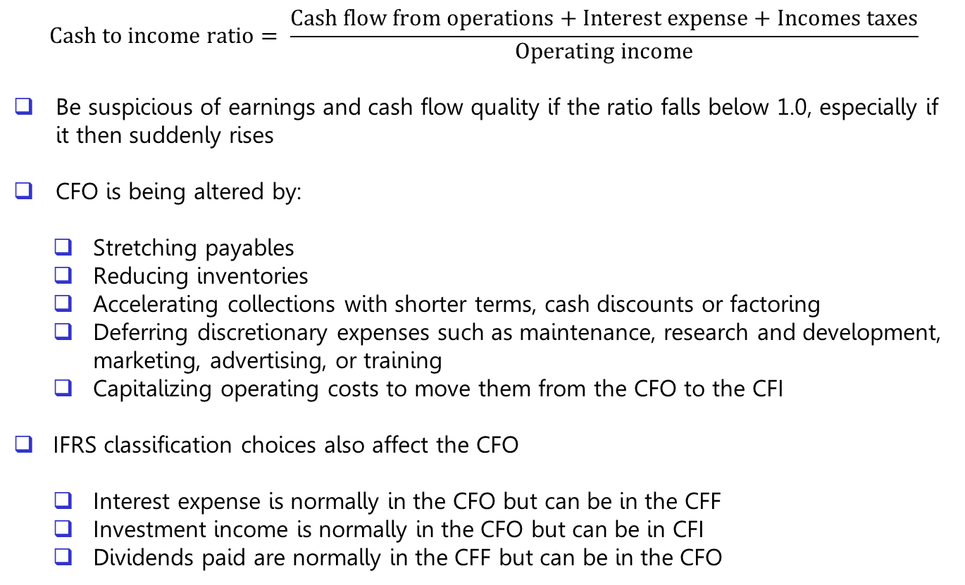
Cash Flow Quality
$$Cash to income ratio= \frac{Cash flow from operations+Interest expense+Incomes taxes}{Operating income}$$
Be suspicious of earnings and cash flow quality if the ratio falls below 1.0, especially if it then suddenly rises
CFO is being altered by:
  Stretching payables
  Reducing inventories
  Accelerating collections with shorter terms, cash discounts or factoring
  Deferring discretionary expenses such as maintenance, research and development, marketing, advertising, or training
  Capitalizing operating costs to move them from the CFO to the CFI
  IFRS classification choices also affect the CFO
  Interest expense is normally in the CFO but can be in the CFF
  Investment income is normally in the CFO but can be in CFI
  Dividends paid are normally in the CFF but can be in the CFO

Slide 8
Balance Sheet Quality
Re-classification of assets and liabilities
Inventories
Fair value accounting
Fixed assets and intangibles
Mergers and acquisitions and goodwill
Asset turnover ratios
Investments in associates
Special purpose entities
Off-balance sheet financing
Deferred income tax assets
Contingent liabilities
Net benefit plan asset or liability

