Slide 1
Dividends and Dividend Policy

Slide 2
Dividend Basics
Types of Dividends
Regular cash dividends
Extra dividends
Special dividends
Liquidating dividends
Stock dividends
Dividend Payment Dates
  Date of declaration
  Ex-dividend date
  Date of record
  Date of payment
Dividend Reinvestment Plan (DRIP)
  Stock purchase plan (SPP)
  Optional cash purchase (OCP) feature
Stock Split, Reverse Stock Split
Rationale for Stock Repurchases
Financial flexibility
Not considered permanent
Signaling
Time the equity markets
Manage EPS and executive compensation
Offset dilution
Adjust capital structure
Distribute excess funds
Better cash and tax planning
Mechanics of a Stock Repurchase
  Open-market share repurchase
  Fixed-price tender offer
  Dutch-auction bid
  Targeted stock repurchase
  Completion rates
  Accelerated share repurchase (ASR)

Slide 3
Is Dividend Policy Relevant? Yes
Factors Favoring Higher or Lower Dividends
  Market Imperfections
  Transaction costs
  Issuance costs
  Irrational investor behaviour
  Taxes
  Agency costs
  Asymmetric information
  Bird-in-hand argument
  Financial flexibility
Practical Considerations
Liquidity position
Restrictive lending conditions
Control issues
Limited access to external financing
Growth rate
Earnings stability
Financial leverage
3

Slide 4
Dividend Theories
Clientele Effect
Signaling Theory
Residual Dividend Theory
Managed Dividends Theory
Phase | Dividend Level
Development | No cash dividends
Growth | Low cash dividends
Expansion | Low to moderate cash dividends
Maturity | Moderate to high cash dividends

Slide 5
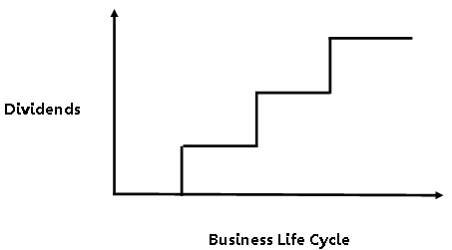
Which Dividend Theory is Right? All of Them!
Long-term Horizon
Residual dividend theory
Clientele effect
Short-term Horizon
Managed dividends theory
Signaling theory

Slide 6
Dividend Policy – Industry Research
Companies are divided into two groups from a dividend policy perspective:
Large, profitable companies that pay large and growing dividends
Small companies that do not pay dividends because they are experiencing financial distress or need their funds to support growth; stock repurchases provide the flexibility they need
Managers fear the market impact of cutting a regular dividend
Managers are focused on maintaining the current dividend and not a specific dividend payout ratio
Managers strongly favour stock repurchases because of their financial flexibility and many other benefits
Dividend-paying companies wish they had never started paying dividends
Non-dividend-paying companies hope they never start paying dividends

