Slide 1
Cost of Capital

Slide 2
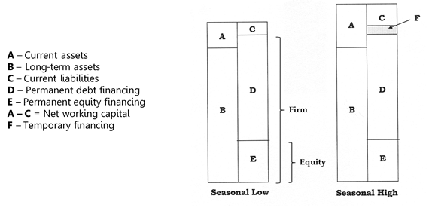
Cost of Capital Perspectives

Slide 3
WACC Formula
(W_{d}) x (k_{d}) + (W_{p}) x (k_{p}) + (W_{c}) x (k_{c})
  W_{d} – Weight of long-term debt
  W_{p} – Weight of preferred shares
  W_{c} – Weight of common shares
  k_{d} – Cost of long-term debt
  k_{p} – Cost of preferred shares
  k_{c} – Cost of common shares

Slide 4
WACC
WACC is the weighted average cost of permanent debt and equity financing only
Special applications include:
WMCC for projects in new industries
Divisional costs of capital
Private companies
Cost of capital components can be estimated using data from a pure play
Pure play is one or a group of comparable companies whose k_{d}, k_{p}, and k_{c} approximate the risk level of the proposed project or division
Pure plays are difficult to find, and their capital structures may not be similar, but their betas can be adjusted to reflect varying borrowing levels
Cost of capital should be adjusted for project risk
Project Risk Category | Project Types | Adjustment | WACC
High | New product expansions | +2% | 10%
Moderate | Cost savings projects Existing product expansions | -0% | 8%
Low | Equipment replacement | -2% | 6%
Mandatory | Environmental or safety equipment | Not applicable | Not applicable

Slide 5
WACC - Weights
Weighting methods include:
  Book value Market value Target capital structure
Book values are easy to obtain, but they are outdated
Market values are current, but they fluctuate considerably and are not available for private companies
Stocks and bonds are issued in large amounts due to economies of scale, so debt and equity weights can vary in the short term
Target capital structure is preferred because it is forward-looking, stable, and does not require a share price
Not all companies know their target capital structure, so market value is the next best choice, followed by book value if market values are not available

Slide 6
Cost of Common Shares
CAPM k_{c} = k_{f} + B_{a} (k_{m} – k_{f})
Implied k_{c} k_{c} = (D₁ / P₀) + g
Treasury spread k_{c} = k_{f} + Spread_{T}
Adjusting beta for financial leverage B_{L} = B_{U} (1 + (1 – t)(D/E))
Cost of other equity securities, such as stock options, warrants, rights, and conversion features, should also be included in WACC, but they normally make up a small part of total equity

Slide 7
Cost of Preferred Shares
Implied k_{p} k_{p} = D₁ / P₀
CAPM is not used to calculate k_{p} because preferred shares have fixed payments like bonds, so their betas are close to zero
If the price of a preferred share cannot be determined, k_{p} may be estimated using the preferred shares of other companies with the same credit rating
A synthetic credit rating can be estimated by a credit rating agency if the company has not undergone a formal credit evaluation
Credit rating agencies have separate rating scales for long-term bonds, short-term debt securities, and preferred shares

Slide 8
Cost of Long-term Debt
Implied k_{d}
P₀ = (I) (1 – (1 + k_{d})^{-n}) / k_{d}) + Principal / (1 + k_{d})^{n}
k_{d} after tax = (k_{d}) (1 – t)
Treasury Spread
k_{d} = k_{T} + Spread_{T}
k_{d} after tax = (k_{d}) (1-t)
Cost of debt can be estimated using bonds with similar credit ratings, terms to maturity, collateral, subordination, and guarantees if a bond price is not available
A synthetic credit rating can be estimated by a credit rating agency if the company has not undergone a formal credit evaluation
Commercial loans and leases do not trade publicly, so recently negotiated lending agreements with the same maturity and similar features are used to approximate the cost of debt
Companies will likely have more than one source of debt financing, so they should determine a weighted-average cost of debt using the current market rate and market value of each issue

Slide 9
Incorporating Issuance Costs
Increase the Cost of Capital
Retained earnings k_{c} = (D₁ / P₀) + g_{d}
New common shares k_{c} = D₁ / (P₀ – f) + g_{d}
New preferred shares k_{p} = D₁ / (P₀ – f)
New long-term debt after tax (k_{d}) (1 – t) / (1 – f)
Include as a Negative Initial Cash Flow
  After-tax issuance costs are included as a negative initial cash flow in the capital budgeting process
  Preferred Approach
The first method is least preferred as this spreads the issuance costs out over the life of the project instead of recognizing them all at the beginning when incurred

