Slide 1
Cost of Capital

Slide 2
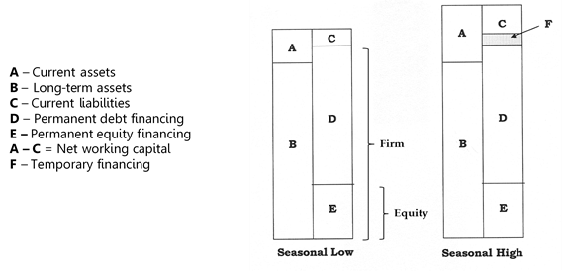
Cost of Capital Perspectives

Slide 3
WACC Formula
(W_{d}) x (k_{d}) + (W_{p}) x (k_{p}) + (W_{c}) x (k_{c})
  W_{d} – Weight of long-term debt
  W_{p} – Weight of preferred shares
  W_{c} – Weight of common shares
  k_{d} – Cost of long-term debt
  k_{p} – Cost of preferred shares
  k_{c} – Cost of common shares

Slide 4
WACC
WACC is the weighted average cost of permanent debt and equity financing only
Special applications include:
WMCC for projects in new industries
Divisional costs of capital
Private companies
Cost of capital components can be estimated using data from a pure play
Pure play is one or a group of comparable companies whose k_{d}, k_{p}, and k_{c} approximate the risk level of the proposed project or division
Pure plays are difficult to find, and their capital structures may not be similar, but their betas can be adjusted to reflect varying borrowing levels
Cost of capital should be adjusted for project risk
Project Risk Category | Project Types | Adjustment | WACC
High | New product expansions | +2% | 10%
Moderate | Cost savings projects Existing product expansions | -0% | 8%
Low | Equipment replacement | -2% | 6%
Mandatory | Environmental or safety equipment | Not applicable | Not applicable

Slide 5
WACC - Weights
Weighting methods include:
  Book value Market value Target capital structure
Book values are easy to obtain, but they are outdated
Market values are current, but they fluctuate considerably and are not available for private companies
Stocks and bonds are issued in large amounts due to economies of scale, so debt and equity weights can vary in the short term
Target capital structure is preferred because it is forward-looking, stable, and does not require a share price
Not all companies know their target capital structure, so market value is the next best choice, followed by book value if market values are not available

Slide 6
Cost of Common Shares
CAPM k_{c} = k_{f} + B_{a} (k_{m} – k_{f})
Implied k_{c} k_{c} = (D₁ / P₀) + g
Treasury spread k_{c} = k_{f} + Spread_{T}
Adjusting beta for financial leverage B_{L} = B_{U} (1 + (1 – t)(D/E))
Cost of other equity securities, such as stock options, warrants, rights, and conversion features, should also be included in WACC, but they usually make up a small part of the total equity

Slide 7
Cost of Preferred Shares
Implied k_{p} k_{p} = D₁ / P₀
CAPM is not used to calculate k_{p} because preferred shares have fixed payments like bonds, so their betas are close to zero
If the price of a preferred share cannot be determined, k_{p} may be estimated using the preferred shares of other companies with the same credit rating
A synthetic credit rating can be estimated by a credit rating agency if the company has not undergone a formal credit evaluation
Credit rating agencies have separate rating scales for long-term bonds, short-term debt securities, and preferred shares

Slide 8
Cost of Long-term Debt
Implied k_{d}
P₀ = (I) (1 – (1 + k_{d})^{-n}) / k_{d}) + Principal / (1 + k_{d})^{n}
k_{d} after tax = (k_{d}) (1 – t)
Treasury Spread
k_{d} = k_{T} + Spread_{T}
k_{d} after tax = (k_{d}) (1-t)
Cost of debt can be estimated using bonds with similar credit ratings, terms to maturity, collateral, subordination, and guarantees if a bond price is not available
A synthetic credit rating can be estimated by a credit rating agency if the company has not undergone a formal credit evaluation
Commercial loans and leases do not trade publicly, so recently negotiated lending agreements with the same maturity and similar features are used to approximate the cost of debt
Companies will likely have more than one source of debt financing, so they should determine a weighted-average cost of debt using the current market rate and market value of each issue

Slide 9
Incorporating Issuance Costs
Increase the Cost of Capital
Retained earnings k_{c} = (D₁ / P₀) + g_{d}
New common shares k_{c} = D₁ / (P₀ – f) + g_{d}
New preferred shares k_{p} = D₁ / (P₀ – f)
New long-term debt after tax (k_{d}) (1 – t) / (1 – f)
Include as a Negative Initial Cash Flow
  After-tax issuance costs are included as a negative initial cash flow in the capital budgeting process
  Preferred Approach
The first method is least preferred as this spreads the issuance costs out over the life of the project instead of recognizing them all at the beginning when incurred

Slide 10
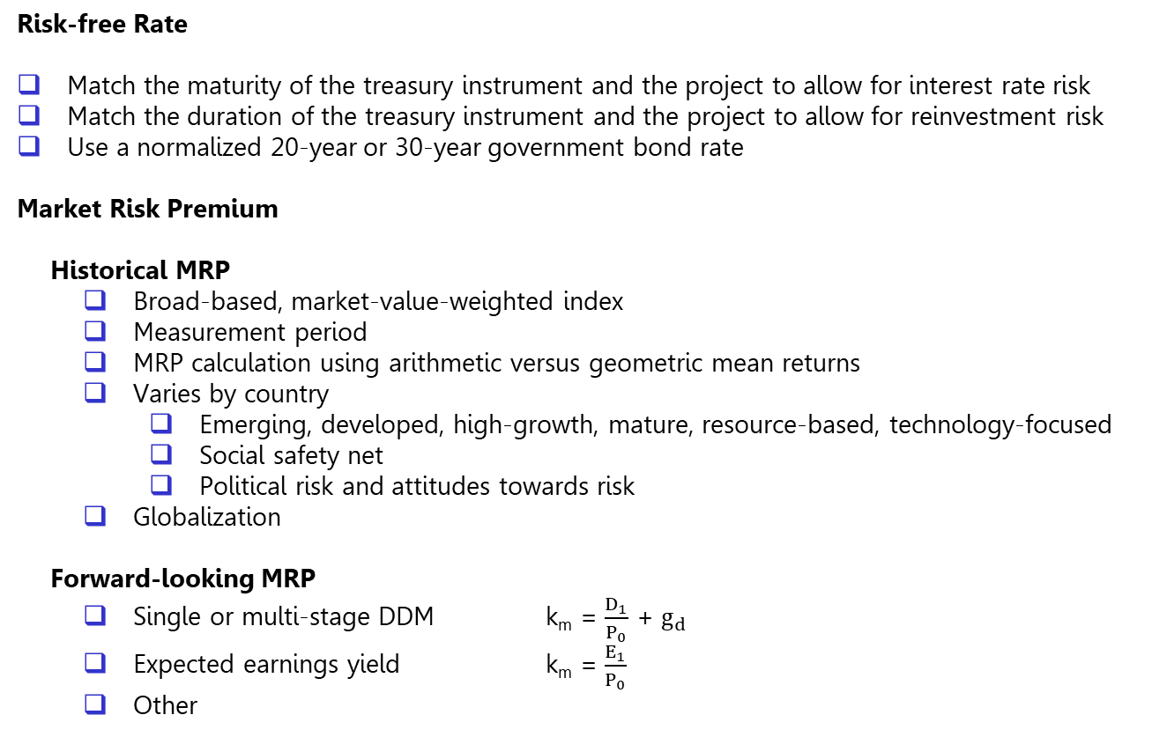
CAPM – Risk-free Rate and MRP
k_{c} = k_{f} + B_{a} (k_{m} – k_{f})
  Risk-free Rate
Match the maturity of the treasury instrument and the project to allow for interest rate risk
Match the duration of the treasury instrument and the project to allow for reinvestment risk
Use a normalized 20-year or 30-year government bond rate
Market Risk Premium
Historical MRP
Broad-based, market-value-weighted index
Measurement period
MRP calculation using arithmetic versus geometric mean returns
Varies by country
  Emerging, developed, high-growth, mature, resource-based, technology-focused
  Social safety net
  Political risk and attitudes towards risk
Globalization
Forward-looking MRP
Single or multi-stage DDM k_{m} = $\frac{D_{1}}{P_{0}}$ + $g_{d}$
Expected earnings yield k_{m} = $\frac{E_{1}}{P_{0}}$
Other

Slide 11

Forward-looking MRP Using 1-Stage Formula
Dividend Yield
Formula 1 $P_{0}$ = $\frac{D_{1} }{k_{m}− g_{d}}$
Formula 2 k_{m} = $\frac{D_{1}}{P_{0}}$ + $g_{d}$
Earnings Yield
Formula 1 $P_{0}$ = $\frac{D_{1} }{k_{m}− g_{d}}$
Formula 2 $P_{0}$ = $\frac{E_{1} × Payout ratio}{k_{m}− \left(ROE\right) (1−Payout ratio)}$
Formula 3 $P_{0}$ = $\frac{E_{1}}{k_{m}}$
Formula 4 $k_{m}$ = $\frac{E_{1}}{P_{0}}$

Slide 12
CAPM – Raw Beta
  Slope of the regression line between the (excess) returns of the market portfolio and the (excess) returns of the company
  Excess returns deduct the 90-day treasury rate to allow for inflation
  Market value-weighted versus equal-weighted index
  Use total return, including dividends, capital gains, and stock splits
Issues when calculating a historical raw beta
  Measurement period
  Return interval – intra-day, daily, weekly, monthly, quarterly, or yearly
  Non-trading bias
  Poor regression results – R-squared, t-stats, coefficient sign, confidence interval
Financial information providers supply beta estimates

Slide 13
CAPM - Raw Beta

Slide 14

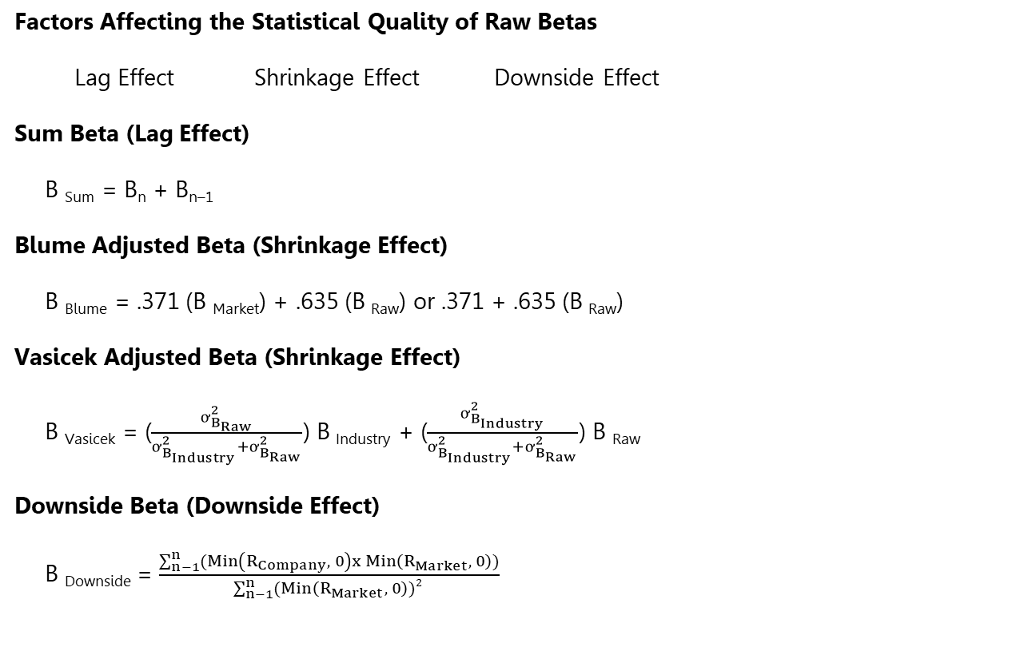
CAPM – Adjusted Betas
Factors Affecting the Statistical Quality of Raw Betas
Lag Effect Shrinkage Effect Downside Effect
Sum Beta (Lag Effect)
B _{Sum} = B_{n} + B_{n–1}
Blume Adjusted Beta (Shrinkage Effect)
B _{Blume} = .371 (B _{Market}) + .635 (B _{Raw}) or .371 + .635 (B _{Raw})
Vasicek Adjusted Beta (Shrinkage Effect)
B _{Vasicek} = ($\frac{ơ_{B_{Raw}}^{2}}{ơ_{B_{Industry}}^{2}+ơ_{B_{Raw}}^{2}}$) B _{Industry} + ($\frac{ơ_{B_{Industry}}^{2}}{ơ_{B_{Industry}}^{2}+ơ_{B_{Raw}}^{2}}$) B _{Raw}
Downside Beta (Downside Effect)
B _{Downside} = $\frac{\sum_{n−1}^{n}{(Min\left(R_{Company}, 0\right)x Min\left(R_{Market}, 0\right))}}{\sum_{n−1}^{n}{(Min\left(R_{Market}, 0\right)})2 }$
$B_{i}$ = $\frac{Cov(R_{i,}R_{m})}{Var(R_{m})}$
B_{i} – Beta of the company
R_{i} – Return or excess return on the stock
R_{m} – Return or excess return on the market portfolio

Slide 15
CAPM – Other Betas
Industry and Peer Group Betas
  Market value-weighted versus equal-weighted
Accounting Betas
Substitute accounting earnings for share price
Regression based on key performance indicators
Unlevered and Levered Betas
Business risk (sales risk, operating risk) versus financial risk
  Financial leverage B_{L} = B_{U} (1 + (1 – t)(D/E))
  Operating leverage B_{U} = B_{OP} (1 + (FC/VC))

Slide 16
CAPM – Size Premiums
CAPM considers market risk only, but firm size is also an important factor
Modified CAPM
k_{c} = k_{f} + B_{a} (k_{m} – k_{f}) + Size Premium
Financial information providers supply size premiums for mid-cap, low-cap, and micro-cap firms
Size premiums occur due to:
Lack of investment diversification
Fewer financial resources and lower barriers to entry
Inability to attract the best personnel and spend enough on R&D and advertising
Lower share liquidity and higher transaction costs
Poorer financial oversight as fewer analysts follow the company
Company Size | Beta | Realized Return | Estimated Return Using CAPM | Size Premium
Large-cap | 0.98 | 11.80% | 11.60% | 0.40%
Mid-cap | 1.12 | 13.70% | 12.56% | 1.14%
Low-cap | 1.23 | 15.16% | 13.28% | 1.88%
Micro-cap | 1.36 | 18.03% | 14.14% | 3.89%

Slide 17
Cost of Long-term Debt
Companies have more than one source of debt financing, so they should determine a weighted-average cost of debt using the current market rate and market value of each issue
Commercial loans and leases do not trade publicly, so recently negotiated agreements with the same maturity and similar features should be used
Cost of debt is difficult to determine when bonds have floating interest rates; are convertible, redeemable, callable; or have purchase fund requirements
A more straightforward way to calculate the cost of debt is to establish a corporate yield curve for other firms with the same credit rating and then prorating these interest rates using the book value of a company’s debt at each maturity
A synthetic credit rating can be estimated by a credit rating agency if a firm has not undergone a formal credit evaluation
Other long-term obligations, including future income taxes, contingent liabilities and pension liabilities, are excluded as they were not negotiated to finance a project and are not interest bearing

Slide 18
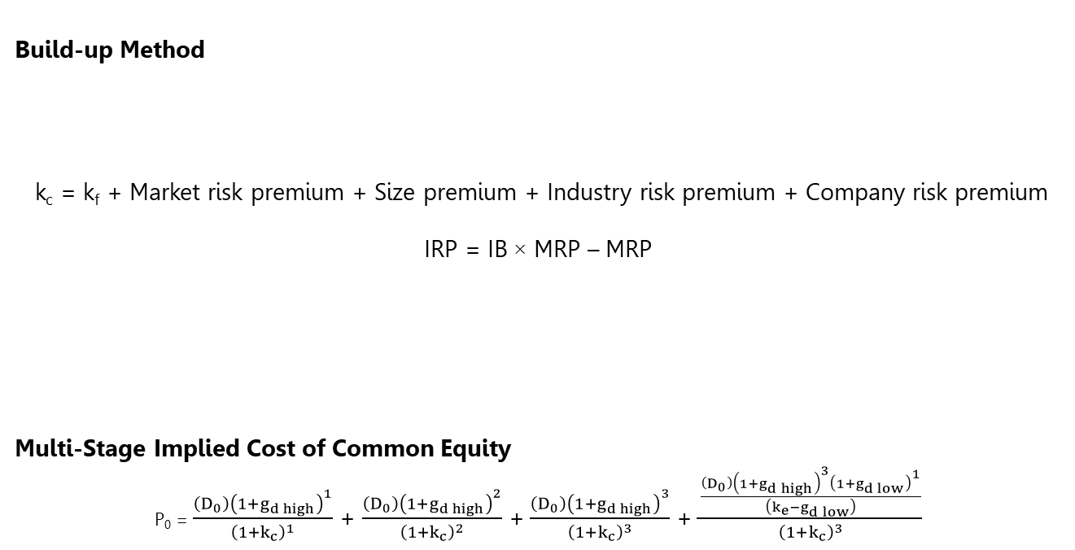
Alternate Cost of Common Equity Models
Build-up Method
k_{c} = k_{f} + Market risk premium + Size premium + Industry risk premium + Company risk premium
IRP = IB × MRP – MRP
Multi-Stage Implied Cost of Common Equity
P₀ = $\frac{{\left(D_{0}\right)\left(1+g_{d high}\right)}^{1}}{{\left(1+k_{c}\right)}^{1}}$ + $\frac{{\left(D_{0}\right)\left(1+g_{d high}\right)}^{2}}{{\left(1+k_{c}\right)}^{2}}$ +$\frac{{\left(D_{0}\right)\left(1+g_{d high}\right)}^{3}}{{\left(1+k_{c}\right)}^{3}}$ + $\frac{\frac{\left(D_{0}\right){\left(1+g_{d high}\right)}^{3}{\left(1+g_{d low}\right)}^{1}}{\left(k_{e}−g_{d low}\right)}}{{\left(1+k_{c}\right)}^{3}}$
Market specific risk
Company specific risk
Variability of operating cash flows Levels of operating and financial leverage Customer and supplier concentration | Strength of management Key person dependence Pending lawsuits Competitive pressures

Slide 19
Alternate Cost of Common Equity Models
Fama-French 3-Factor Model
k_{c} = k_{f} + B_{MRP} (k_{m} – k_{f}) + B_{SMB} (SMB) + B_{HML} (HML)
  Small Minus Big (SMB) – Difference in return between the smallest 30% (small cap) and largest 30% (large cap) of stocks based on market capitalization
  High Minus Low (HML) – Difference in return between the highest 50% BVPS/P ratio (value) and lowest 50% BVPS/P ratio (growth) stocks based on market capitalization

Slide 20
Kroll (Duff & Phelps)
References
Stocks, Bonds, Bills, and Inflation (SBBI) Yearbook
Valuation Handbook – U.S. Guide to Cost of Capital
Valuation Handbook – U.S. Industry Cost of Capital
International Valuation Handbook – Guide to Cost of Capital
International Valuation Handbook – Industry Cost of Capital
Cost of Capital Navigator
Industry Data
CAPM Estimates
U.S. normalized risk-free rate = 3.5%
U.S. MRP = 5.0%

