Slide 1
Capital Budgeting

Slide 2
Capital Budgeting Process
1. Project idea generation
  2. Screening of proposals
3. Project evaluation
      Payback period
          Discounted payback period
          Accounting rate of return (ARR)
        Internal rate of return (IRR)
        Net present value (NPV)
        Profitability index (PI)
4. Preparation of the capital budget
5. Monitoring and post-completion audits

Slide 3
Multiple IRRs
RRR (%) | Cash Flows (CAD) |  |  |  |  | Difference (CAD) | NPV (CAD)
 | Year 0 | Year 1 |  | Year 2
0.0 | -58.00 | +149.00 | % Change | -94.00 | % Change | +55.00 | -3.00
11.4 | -58.00 | +133.75 | -10.23% | -75.75 | +19.41% | +58.00 | +0.00
26.2 | -58.00 | +118.07 | -11.72% | -59.02 | +22.09% | +59.05 | +1.05
45.5 | -58.00 | +102.41 | -13.26% | -44.40 | +24.77% | +58.00 | +0.00
50.0 | -58.00 | +99.33 | -3.01% | -41.78 | +5.90% | +57.56 | -0.44

Slide 4
Mutually Exclusive Projects
Year | Project 1 | Project 2
0 | -CAD 220 | -CAD 220
1 | 100 | 30
2 | 80 | 70
3 | 80 | 110
4 | 60 | 130
Total Cash Inflows | CAD 320 | CAD 340
IRR | 18% | 16%
RRR | Project 1 NPV (CAD) | Project 2 NPV (CAD)
0% | 100.00 | 120.00
5% | 66.27 | 74.04
6% | 60.23 | 65.93
7% | 54.41 | 58.15
8% | 48.79 | 50.67
9% | 43.36 | 43.48
10% | 38.11 | 36.56
15% | 14.35 | 5.67
20% | -5.88 | -20.04

Slide 5
Applying NPV Analysis
Types of Decisions
Replacement
Standalone
Types of Projects
Independent
Mutually exclusive
Contingent
Estimating Cash Flows
Include relevant incremental after-tax cash flows
Use opportunity cost
Ignore sunk costs
Incorporate side effects
Consider qualitative factors
Be cautious of overhead allocation
Ignore financing costs
Apply the correct discount rate

Slide 6
Applying NPV Analysis
1. Initial Cash Flows
  Cost of assets
  CCA tax shield on assets
  Increase or decrease in NWC
2. Recurring Cash Flows
  Incremental after-tax net cash flows
3. Terminal Cash Flows
  Disposal value of assets
  Loss of tax shield on the disposal of assets
  Return of NWC to previous levels
  Decommissioning costs
Rule: Accept all projects with a positive NPV

Slide 7
Applying NPV Analysis – CCA
Acquisitions and Disposals
Sale of old asset | CAD 7,000
Acquisition | CAD 31,000
CCA rate | 20%
UCC beginning | CAD 28,000
Half of the net acquisitions | 12,000
Balance | 40,000
CCA – Year 1 | (8,000)
UCC ending | CAD 32,000
Half of the net acquisition | 12,000
Balance | 44,000
CCA – Year 2 | (8,800)
UCC ending | CAD 35,200
Present value of CCA tax shield = (Investment) (Marginal tax rate) ($\frac{CCA rate}{CCA rate+RRR}$) ($\frac{2 + RRR}{2 (1+RRR)}$)

Slide 8
Incorporating Inflation
Nominal Approach: Uses nominal dollar future cash flows and a nominal RRR
Real Approach: Uses real dollar future cash flows and a real RRR
Calculating the Nominal Rate Using the Fischer Effect
Nominal rate = (1 + Real rate) x (1+ Inflation rate) – 1
Nominal rate: 8.0%
Inflation: 2.0%
0.08 = (1 + Real rate) x (1 + 0.02) – 1.0
X =0.0588 or 5.88%

Slide 9
Capital Rationing
Reasons for Capital Rationing
Soft rationing
Hard rationing

Slide 10
Capital Rationing Using Solver
Project | Initial Investment (CAD) | Present Value (CAD) | Profitability Index
A | 1,000,000 | 1,700,000 | 1.70
B | 2,000,000 | 3,000,000 | 1.50
C | 500,000 | 600,000 | 1.20
D | 500,000 | 585,000 | 1.17
E | 500,000 | 575,000 | 1.15
Additional Information
  Projects A and B are mutually exclusive
  All projects are of equal length
  RRR is 7.0%
  Total capital budget is CAD 2,500,000

Slide 11
Capital Rationing Using Solver
Alternative 1
Project | Initial Investment (CAD) | Present Value (CAD) | NPV (CAD)
A | 1,000,000 | 1,700,000 | 700,000
C | 500,000 | 600,000 | 100,000
D | 500,000 | 585,000 | 85,000
E | 500,000 | 575,000 | 75,000
Total | 2,500,000 | 3,460,000 | 960,000
Alternative 2
Project | Initial Investment (CAD) | Present Value (CAD) | NPV (CAD)
B | 2,000,000 | 3,000,000 | 1,000,000
C | 500,000 | 600,000 | 100,000
Total | 2,500,000 | 3,600,000 | 1,100,000

Slide 12
Capital Rationing Using Solver
 | A | B | C | D | E | F
1 | Project | Initial Investment | NPV | Selection | Total Investment | Total NPV
2 | A | 1,000,000 | 700,000 |  | =D2*B2 | =D2*C2
3 | B | 2,000,000 | 1,000,000 |  | =D3*B3 | =D3*C3
4 | C | 500,000 | 100,000 |  | =D4*B4 | =D4*C4
5 | D | 500,000 | 85,000 |  | =D5*B5 | =D5*C5
6 | E | 500,000 | 75,000 |  | =D6*B6 | =D6*C6
7 |  |  |  | Total | =Sum(E2..E6) | =Sum(F2..F6)
Maximize F7 (Total Profit) Constraints
Vary D2..D6 (Selection) Total Investment is ≤ CAD 2,500,000
Selection is “0” or “1”
A and B cannot both equal “1”

Slide 13
Comparing Projects of Varying Lives
  Chaining
  Equal annual annuity (EAA)

Slide 14
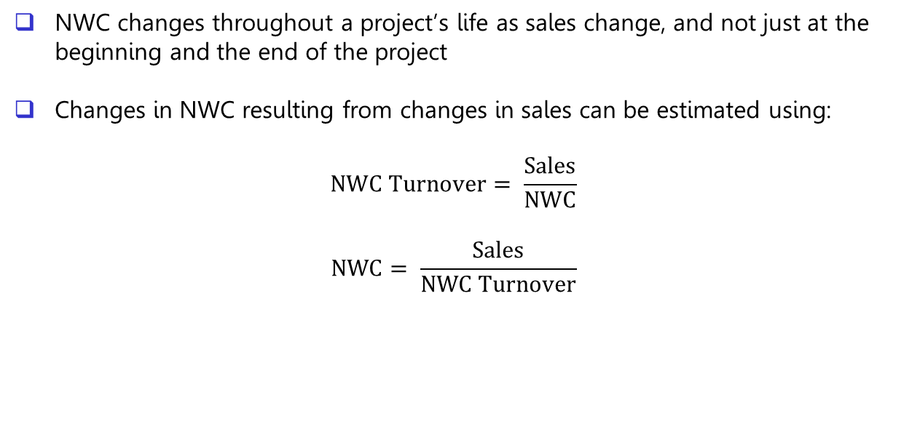
Changes in NWC
NWC changes throughout a project’s life as sales change, and not just at the beginning and the end of the project
Changes in NWC resulting from changes in sales can be estimated using:
$$NWC Turnover= \frac{Sales}{NWC}$$
$$NWC= \frac{Sales}{NWC Turnover}$$

Slide 15
Taxation Effects of Terminal Cash Flows
Land
Not subject to CCA as it is a non-depreciating asset
Capital gains or losses need to be recognized when an asset is sold for more or less than its original cost
Building
Subject to CCA as it is a depreciable asset
If sold above original cost, the cost is deducted from the CCA pool, and a capital gain is calculated on the difference
Capital losses cannot occur on a depreciable asset, but terminal losses and recaptures are possible
Recaptures and terminal losses are much more likely with buildings, as each property is held in its own pool

Slide 16
Taxation Effects of Terminal Cash Flows
Equipment
Subject to CCA as it is a depreciable asset
If sold above original cost, the cost is deducted from the CCA pool, and a capital gain is calculated on the difference
Capital losses cannot occur on a depreciable asset, but terminal losses and recaptures are possible

Slide 17
Managing Risk
1. Establish a minimum payback period
2. Adjust the RRR
3. Sensitivity analysis
Category | Examples | Adjustment Factor | Discount Rate
High risk | New products | +6% | 20%
Moderate risk | Cost savings Expansions of existing equipment | -0% | 14%
Low risk | Replacement of existing equipment | -4% | 10%
Mandatory | Pollution control equipment | Not applicable | Not applicable

Slide 18
Managing Risk
4. Scenario analysis
5. Simulation
6. Management options using decision trees
Abandonment Timing Growth Flexibility
 | Annual Cash Inflows (CAD)
RRR | 80,000 | 90,000 | 100,000 | 110,000 | 120,000
6% | -42,140 | -22 | 42,100 | 84,220 | 126,340
8% | -59,660 | 19,730 | 22,200 | 60,130 | 100,060
10% | -75,820 | 37,910 | 0 | 37,910 | 75,820
Event | Value (CAD) | Probability | Expected Value (CAD)
Best case | 126,340 | 0.25 | 31,585
Most likely | 22,200 | 0.50 | 11,100
Worst case | -75,820 | 0.25 | -18,955
 |  | Total | 23,730

Slide 19
Cash Flow Assumptions
Project A Capital cost: CAD 10,000 Annual cash inflows: CAD 5,000 Annual cash outflows: CAD 2,000 Life of project: 10 years RRR: 8.0%, compounded Yearly NPV Under Different Cash Flow Assumptions Year-end: CAD 10,130 Revenue at year-end, costs monthly: CAD 9,645 | Project B Capital cost: CAD 10,000 Annual cash inflows: CAD 50,000 Annual cash outflows: CAD 47,000 Life of project: 10 years RRR: 8.0%, compounded yearly NPV Under Different Cash Flow Assumptions Year-end: CAD 10,130 Revenue at year-end, costs monthly: -CAD 1,273

Slide 20
Complex Capital Budgeting with Spreadsheets
 |  | Year 1 | Year 10
 | Initial | Month 1 | Month 12
Initial Cash Flows
Land | $$$
Building | $$$
Equipment | $$$
Initial change in NWC | $$$
Recurring Cash Flows
Sales |  | $$$ | $$$
Cost of sales |  | $$$ | $$$
Non-traceable factory costs |  | $$$ | $$$
Selling costs |  | $$$ | $$$
Administration costs |  | $$$ | $$$
CCA |  | $$$ | $$$
Income tax |  | $$$ | $$$
Net operating cash flows |  | $$$ | $$$
Recurring change in NWC |  | $$$
Terminal Cash Flows
Sale of land |  |  | $$$
Capital gains tax |  |  | $$$
Sale of building |  |  | $$$
Recapture or terminal loss |  |  | $$$
Sale of equipment |  |  | $$$
Present value of future CCA deductions |  |  | $$$
Terminal change in NWC |  |  | $$$
Net Cash Flows | $$$ | $$$ | $$$
RRR | %%% | %%% | %%%
Initial and monthly NPV | $$$ | $$$ | $$$
Cumulative initial and monthly NPV | $$$ | $$$ | $$$
Total NPV | $$$
Annual IRR | %%%
Discounted Payback | Date

