Slide 1
Business Valuation

Slide 2
Business Valuation
Definitions of Value
Market value
Fair market value
Investment or acquisition value
Intrinsic value
Going-concern value
Liquidation or break-up value
Types of Analysts
Sell-side analyst
Buy-side analyst
Applications
Private company transactions
Initial or secondary offerings
Buy, sell or hold recommendations
Timing stock repurchases
Internal management
Take-over bids
Fairness opinions
Ownership percentages for venture capital
Valuing divestitures, spin-offs or going private transactions
Liquidations or reorganizations
Share-based compensation
Fair value accounting in financial reporting
Transfer pricing
Fair value of assets for tax purposes
Litigation support

Slide 3
Business Valuation Methods
Income approach
Dividend discount model (DDM)
Free cash flows to equity (FCFE)
Free cash flows to the firm (FCFF)
Market multiples approach
P/E, P/S, P/BV

Slide 4
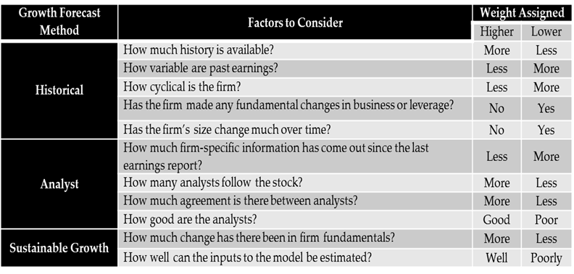
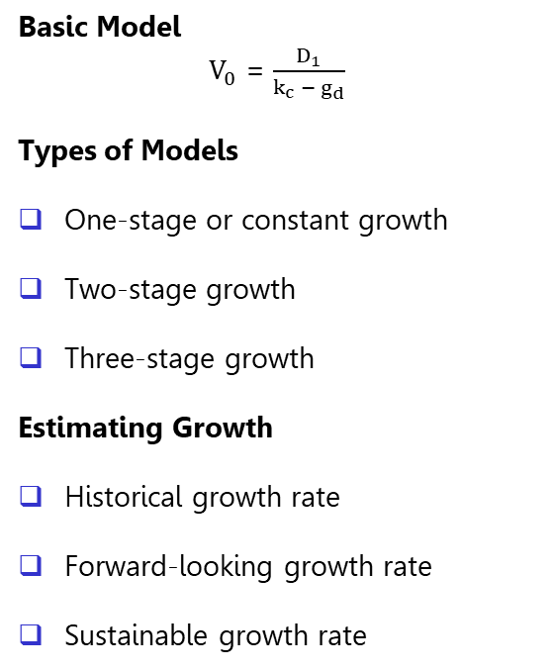

Income Approach – DDM
Basic Model
$V_{0}$ = $\frac{D_{1}}{k_{c} −{ g}_{d}}$
Types of Models
One-stage or constant growth
Two-stage growth
Three-stage growth
Estimating Growth
Historical growth rate
Forward-looking growth rate
Sustainable growth rate
Changing Payouts, Betas, ROAs, Debt Ratios
$ROE$ = $\frac{(Net income / Sales) x (Sales / Total assets)}{(1− \left(Total debt\right) / (Total assets)) }$

Slide 5
Income Approach – Free Cash Flows
Why?
Many companies do not pay dividends
Some pay dividends well above or below what they should pay
Why?
Reliable market value of debt is available
FCFF is less likely to be negative for highly leveraged or cyclical firms
Borrowing may change in the near term
WACC is more stable than k_{c}
FCFE
FCFE = NI + NCC – Δ NWC – CE + NB
FCFE = CFO - CE + NB
FCFE = NI – (CE – D) (1 – DR) – ΔNWC (1 – DR)
FCFF
FCFF = EBIT (1-TR) + NCC – CE – Δ NWC
FCFF = CFO + (I) (1 – TR) – CE

Slide 6
Market Multiples – P/E
Market Multiples Formula
Calculating EPS
Trailing EPS – previous 4 quarters
Leading (Forward) EPS – next 4 quarters
Use diluted EPS based on the analyst’s forecast, other analysts, or a consensus of analysts
Adjusted/Normalized Earnings
Adjust earnings for aggressive revenue and cost recognition practices
Adjust earnings by eliminating non-recurring items like discontinued operations, restructuring charges, and gains or losses on asset sales
Standardize accounting policies so company earnings are more comparable
Normalize earnings to smooth out the effect of the business cycle or business losses using:
  Average EPS
  Average ratios
Benchmark P/E Multiple
Comparable companies
  Sub-industry or industry comparison
Historical average multiples

Slide 7
Industrial Classification Systems
Global Industry Classification Standard (GICS)

Slide 8
Weighted-Average Valuation
Method | Estimate (CAD) | Weight
DDM | 43.62 | 25%
FCFE | 36.42 | 30%
FCFF | 44.09 | 25%
P/E | 51.33 | 10%
P/BV | 53.87 | 10%
Firm Value | 43.37 | 100%

Slide 9
Control Premiums and Marketability Discounts
Investment or Acquisition Value
Control Premium
Marketable Minority Interest Value
Marketability Discount
Non-Marketable Minority Interest Value

Slide 10
Professional Designations
Chartered Business Valuator (CBV)
Educational Program
1. Complete six courses
Level I – Introductory Business Valuation
Level II – Intermediate Business Valuation
Level III – Advanced Business Valuation
Level IV – Special Topics in Business Valuation
Two electives from the following:
Litigation Support in Business Valuation
Corporate Finance
Valuation for Financial Reporting
Private Investments
2. Minimum 1,500 hours of experience
3. Pass the Membership Qualification Exam (MQE)
Chartered Financial Analyst (CFA)
Educational Program
1. Complete Levels 1, 2, and 3 over three years covering:
Ethical and professional standards
Quantitative methods
Economics
Financial reporting and analysis
Corporate finance
Equity investments
Fixed income
Derivatives
Alternative investments
Portfolio management and wealth planning
2. Minimum 4,000 hours of work experience
3. Pass a 6-hour exam at the end of each level

