Slide 1
Business Valuation

Slide 2
Business Valuation
Definitions of Value
Market value
Fair market value
Investment or acquisition value
Intrinsic value
Going-concern value
Liquidation or break-up value
Types of Analysts
Sell-side analyst
Buy-side analyst
Applications
Private company transactions
Initial or secondary offerings
Buy, sell or hold recommendations
Timing stock repurchases
Internal management
Take-over bids
Fairness opinions
Ownership percentages for venture capital
Valuing divestitures, spin-offs or going private transactions
Liquidations or reorganizations
Share-based compensation
Fair value accounting in financial reporting
Transfer pricing
Fair value of assets for tax purposes
Litigation support

Slide 3
Business Valuation Methods
Income approach
Dividend discount model (DDM)
Free cash flows to equity (FCFE)
Free cash flows to the firm (FCFF)
Market multiples approach
P/E, P/S, P/BV, P/CFO, P/FCFE, EV/EBITDA, EV/FCFF
Asset-based approach with excess earnings
Residual income approach

Slide 4
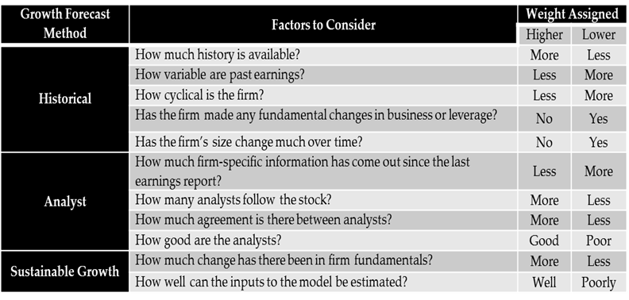
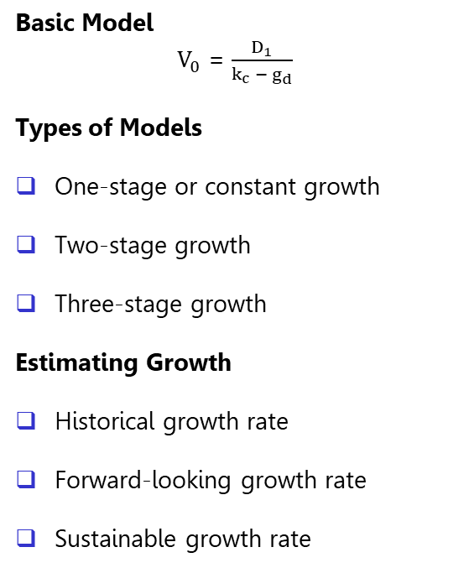

Income Approach – DDM
Basic Model
$V_{0}$ = $\frac{D_{1}}{k_{c} −{ g}_{d}}$
Types of Models
One-stage or constant growth
Two-stage growth
Three-stage growth
Estimating Growth
Historical growth rate
Forward-looking growth rate
Sustainable growth rate
Changing Payouts, Betas, ROAs, Debt Ratios
Implied k_{c} or g_{d}
$ROE$ = $\frac{(Net income / Sales) x (Sales / Total assets)}{(1− \left(Total debt\right) / (Total assets)) }$

Slide 5
Income Approach – Free Cash Flows
Why?
Many companies do not pay dividends
Some pay dividends well above or below what they should pay
Why?
Reliable market value of debt is available
FCFF is less likely to be negative for highly leveraged or cyclical firms
Borrowing may change in the near term
WACC is more stable than k_{c}
FCFE
FCFE = NI + NCC – Δ NWC – CE + NB
FCFE = CFO - CE + NB
FCFE = NI – (CE – D) (1 – DR) – ΔNWC (1 – DR)
FCFF
FCFF = EBIT (1-TR) + NCC – CE – Δ NWC
FCFF = CFO + (I) (1 – TR) – CE

Slide 6
Long-term Financial Planning
Percentage of sales method is used to prepare long-term financial plans, as it can be quickly developed based on a sales forecast
The method is based on two assumptions:
Company’s operating expenses, working capital items and long-term assets grow at the same rate as sales and thus remain at the same percentage of sales
For long-term liabilities and equity, their total value will be equal to assets minus current liabilities, and the proportion of each is dependent on the company’s target capital structure
For operating expenses, these assumptions are reasonable
For working capital and long-term assets, it assumes a constant capital intensity ratio
Analysts may adjust the historical percentages for changes in the gross profit margin, fixed operating costs, overcapacity, or new credit or inventory policies

Slide 7
Income Approach – Special Cases
Non-operating assets
Multi-unit businesses
Cyclical companies
Company average ratios
Industry average ratios
Distressed firms

Slide 8
Market Multiples – P/E
Market Multiples Formula
Calculating EPS
Trailing EPS – previous 4 quarters
Leading (Forward) EPS – next 4 quarters
Use diluted EPS based on the analyst’s forecast, other analysts, or a consensus of analysts
Adjusted/Normalized Earnings
Adjust earnings for aggressive revenue and cost recognition practices
Adjust earnings by eliminating non-recurring items like discontinued operations, restructuring charges, and gains or losses on asset sales
Standardize accounting policies so company earnings are more comparable
Normalize earnings to smooth out the effect of the business cycle or business losses using:
  Average EPS
  Average ratios
Benchmark P/E Multiple
Justified P/E multiple based on fundamentals
Fundamentals are risk, growth and payout
Comparable companies
  Sub-industry or industry comparison
Multi-regression analysis
Historical average multiples
Leading P/E
Trailing P/E

Slide 9
Industrial Classification Systems
Global Industry Classification Standard (GICS)

Slide 10
Market Multiples – P/S
Justified P/S Multiple Based on Fundamentals
Fundamentals are risk, growth, payout, and NPM
Sales should be adjusted for aggressive revenue recognition practices and non-recurring items, and normalized for the business cycle

Slide 11
Market Multiples – P/BV
Justified P/BV Multiples Based on Fundamentals
Fundamentals are risk, growth, payout, and ROE
Recalculate book value to include all recognized and unrecognized assets and liabilities at their fair market value

Slide 12
Market Multiples Approach – P/CFO, P/FCFE
Justified P/CFO Multiple Based on Fundamentals
Fundamentals are risk, growth, and payout based on cash flows
Justified P/FCFE Multiple Based on Fundamentals
Fundamentals are risk and growth
CFO and FCFE can be manipulated by:
Reclassifying interest and dividends
Capitalizing additional costs
Delaying discretionary expenses
Stretching payables or reducing inventories
Accelerating collections
CFO and FCFE should be adjusted to eliminate any manipulation and normalized for the business cycle

Slide 13
Market Multiples – EV/EBITDA, EV/FCFF
What is EV?
EV = MV common equity + MV debt + MV preferred shares – Cash and Cash Equivalents – Short-term investments
What is FCFF?
FCFF = EBIT (1-TR) + NCC – CE – Δ NWC
How are they connected?
Justified EV/FCFF Multiple Based on Fundamentals
Fundamentals are risk and growth
FCFF should be normalized and adjusted like FCFE

Slide 14
Asset-Based Approach
Step 1 - Obtain a historical cost-based balance sheet
Step 2 - Identify any unrecognized assets and liabilities
Unrecorded tangible or intangible assets
Contingent liabilities
Non-capitalized leases
Other off-balance sheet assets and liabilities
Step 3 - Measure all assets and liabilities at fair value if material
Inventory – Replacement cost or net realizable value
Long-term assets – Market, income or cost approaches
Step 4 - Estimate the fair value of any goodwill as the PV of excess earnings
Excess earnings = FCFF – (Net assets) (WACC)
Step 5 - Construct a fair value-based balance sheet

Slide 15
Residual Income Approach
Basic Formula
RI = Net income – Required rate of return
Firm’s value can be determined using the one, two or three-stage model

Slide 16
Special Applications in Business Valuation
Investment or Acquisition Value
Control Premium
Marketable Minority Interest Value
Marketability Discount
Non-Marketable Minority Interest Value
Valuing Private Companies
Quality of financial information
Financial projections
Cost of capital
Lack of comparable data

Slide 17
Professional Designations
Chartered Business Valuator (CBV)
Educational Program
1. Complete six courses
Level I – Introductory Business Valuation
Level II – Intermediate Business Valuation
Level III – Advanced Business Valuation
Level IV – Special Topics in Business Valuation
Two electives from the following:
Litigation Support in Business Valuation
Corporate Finance
Valuation for Financial Reporting
Private Investments
2. Minimum 1,500 hours of experience
3. Pass the Membership Qualification Exam (MQE)
Chartered Financial Analyst (CFA)
Educational Program
1. Complete Levels 1, 2, and 3 over three years covering:
Ethical and professional standards
Quantitative methods
Economics
Financial reporting and analysis
Corporate finance
Equity investments
Fixed income
Derivatives
Alternative investments
Portfolio management and wealth planning
2. Minimum 4,000 hours of work experience
3. Pass a 6-hour exam at the end of each level

