Slide 1
Bond Valuation and Interest Rates

Slide 2
Bonds Versus Commercial Loans
Bonds are preferred over commercial loans because they:
Enable businesses to bypass financial institutions, lowering their borrowing costs
Provide greater market liquidity to investors who will accept lower interest rates
Have a less restrictive monitoring process and fewer lending conditions
Provide funding for much longer periods
Commercial loans are preferred over bonds because they:
Can be arranged quickly as they do not go through the public placement process and are originated using the lender’s extensive branch system
Have lower up-front issuance costs that small issuers can more easily absorb
Can better customize repayment
Are easier to modify than bond indentures
Do not require a credit rating
Avoid the detailed financial disclosures required in a public placement

Slide 3
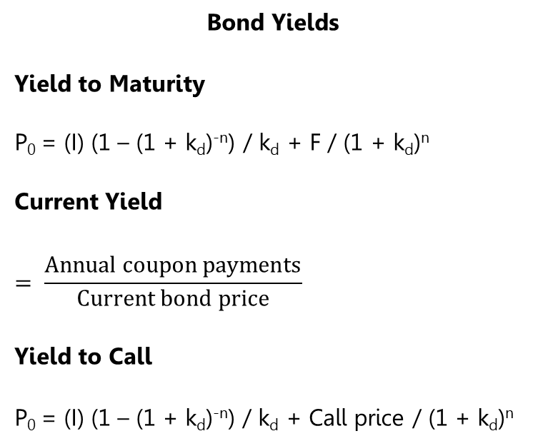
Bond Valuation
Straight Bond
P₀ = (I) (1 – (1 + k_{d})^{-n}) / k_{d} + F / (1 + k_{d})^{n}
Zero-Coupon Bond
P₀ = F / (1 + k_{d})^{n}
Floating-Rate Bond
P₀ = (I) (1 – (1 + k_{d})^{-n}) / k_{d} + F / (1 + k_{d})^{n}
Bond Yields
Yield to Maturity
P₀ = (I) (1 – (1 + k_{d})^{-n}) / k_{d} + F / (1 + k_{d})^{n}
Current Yield
$$= \frac{Annual coupon payments}{Current bond price}$$
Yield to Call
P₀ = (I) (1 – (1 + k_{d})^{-n}) / k_{d} + Call price / (1 + k_{d})^{n}
PV of interest payments
PV of the return of investment

Slide 4
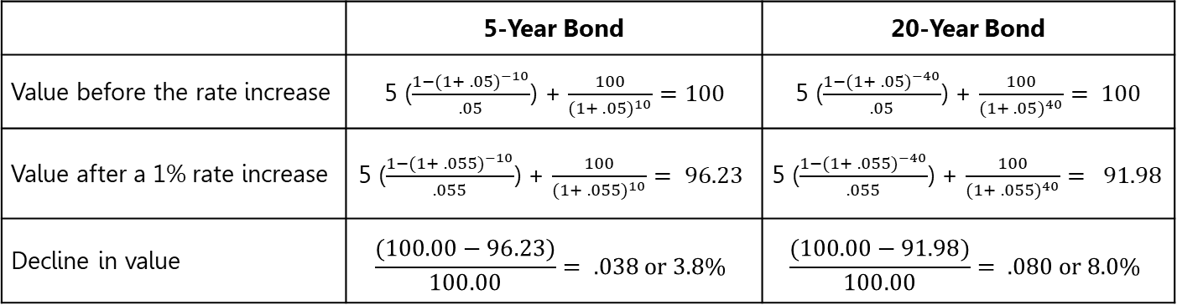
Interest Rate Risk
Straight Bond
Investment: CAD 100
Coupon rate: 10%, compounded semi-annually
Market rate: 10%, compounded semi-annually
Term: 5 years
 | 5-Year Bond | 20-Year Bond
Value before the rate increase | 5 ($\frac{{1−(1+ .05)}^{−10}}{.05}$) + $\frac{100}{{(1+ .05)}^{10}}=100$ | 5 ($\frac{{1−(1+ .05)}^{−40}}{.05}$) + $\frac{100}{{(1+ .05)}^{40}}= 100$
Value after a 1% rate increase | 5 ($\frac{{1−(1+ .055)}^{−10}}{.055}$) + $\frac{100}{{(1+ .055)}^{10}}= 96.23$ | 5 ($\frac{{1−(1+ .055)}^{−40}}{.055}$) + $\frac{100}{{(1+ .055)}^{40}}= 91.98$
Decline in value | $$\frac{(100.00−96.23)}{100.00}= .038 or 3.8\%$$ | $$\frac{(100.00−91.98)}{100.00}= .080 or 8.0\%$$

Slide 5
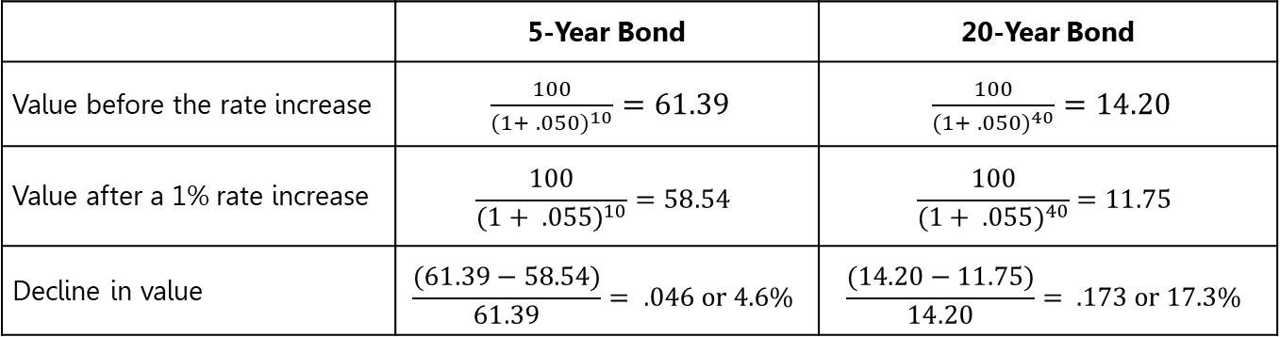
Interest Rate Risk
Zero-coupon Bond
Investment: CAD 100
Coupon rate: 0%, compounded semi-annually
Market rate: 10%, compounded semi-annually
Term: 5 years
 | 5-Year Bond | 20-Year Bond
Value before the rate increase | $\frac{100}{{(1+ .050)}^{10}}=61.39$ | $\frac{100}{{(1+ .050)}^{40}}=14.20$
Value after a 1% rate increase | $$\frac{100}{{(1+ .055)}^{10}}=58.54$$ | $$\frac{100}{{(1+ .055)}^{40}}=11.75$$
Decline in value | $$\frac{(61.39−58.54)}{61.39}= .046 or 4.6\%$$ | $$\frac{(14.20−11.75)}{14.20}= .173 or 17.3\%$$

Slide 6
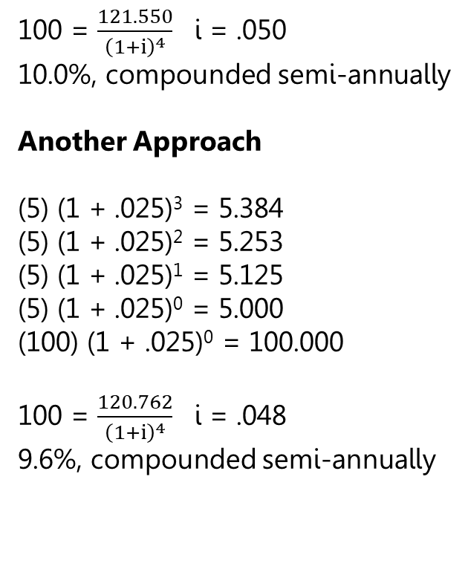
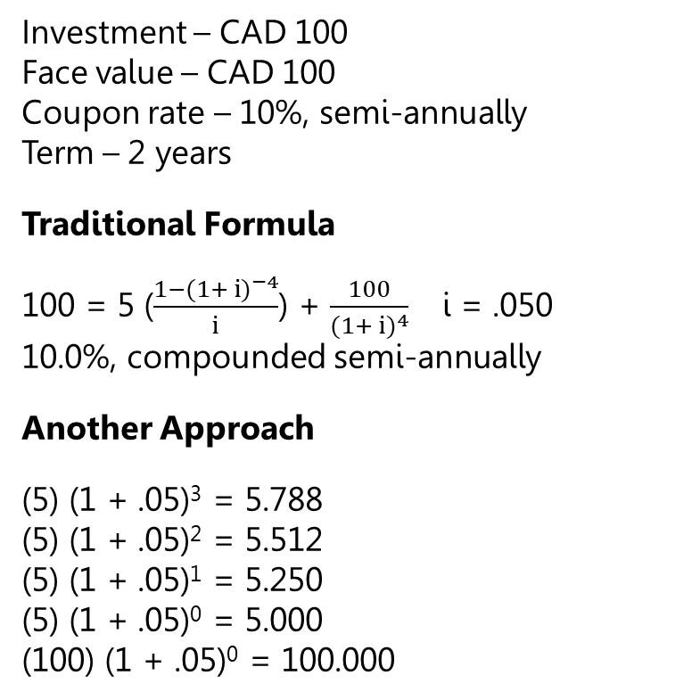
Reinvestment Risk
Investment – CAD 100
Face value – CAD 100
Coupon rate – 10%, semi-annually
Term – 2 years
Traditional Formula
100 = 5 ($\frac{{1−(1+ i)}^{−4}}{i}$) + $\frac{100}{{(1+ i)}^{4}}$ i = .050
10.0%, compounded semi-annually
Another Approach
(5) (1 + .05)³ = 5.788
(5) (1 + .05)² = 5.512
(5) (1 + .05)¹ = 5.250
(5) (1 + .05)⁰ = 5.000
(100) (1 + .05)⁰ = 100.000
100 = $\frac{121.550}{{\left(1+i\right)}^{4}}$ i = .050
10.0%, compounded semi-annually
Another Approach
(5) (1 + .025)³ = 5.384
(5) (1 + .025)² = 5.253
(5) (1 + .025)¹ = 5.125
(5) (1 + .025)⁰ = 5.000
(100) (1 + .025)⁰ = 100.000
100 = $\frac{120.762}{{\left(1+i\right)}^{4}}$ i = .048
9.6%, compounded semi-annually

Slide 7
Bond Features and Markets
Bond Features
Interest rates and currency
Bond indentures and protective covenants
Sinking funds
Collateral
Subordination
Guarantees
Credit rating
Callable bonds
Convertible bonds
Bond Markets
Public placement
Private placement
Secondary market
Over-the-counter market
Bid and ask price
Why a Private Placement?
Negotiate funding more quickly
Lower issuance costs
More receptive to smaller, higher-risk issues
Hand-pick more compatible investors with the desired competencies
Diversify funding sources
Customization of repayment and loan conditions
No credit rating requirement
No public disclosure of company information

Slide 8
Interest Rates
Interest Rate Components
Real Risk-Free Rate
+
Inflation Premium
=
Nominal Risk-Free Rate
+
Interest Rate Risk
+
Reinvestment Risk
=
Government Rate
+
Additional Risk Premium
=
Nominal Required Rate of Return
Additional Risk Premium
Default
Liquidity
Size of issue
Covenants, collateral, guarantees
Call risk
Exchange risk
Country and political risk
Tax risk

Slide 9
Yield Curve
Inverted
Flat
Normal

Slide 10
Theories Explaining the Shape of the Yield Curve
Liquidity Premium Theory
Segmentation Theory
Expectation Theory

Slide 11
Interest Rate Forecasting
Spot interest rate: Rate on a loan that starts today
Forward interest rate: Rate on a loan that starts at a future date
Spot and forward interest rates can be denoted using the symbols:
  _{a}r_{b}
  r = interest rate
  a = start time of the loan
  b = length of the loan
The yield curve is a collection of spot interest rates that can be used to forecast implied forward rates:
  _{a}r_{b} (1 + ₀r_{a} )ª x (1 + _{a}r_{b} )^{b} = (1 + ₀r_{(a+b)})^{(a+b)}
  ₁r₂ (1 + ₀r₁ )¹ x (1 + ₁r₂ )² = (1 + ₀r₃)³

