Slide 1
Advanced Profitability Analysis

Slide 2
Consolidated Income Statement
Sales 817,000
Cost of sales 450,000
Gross profit 367,000
Operating expenses
Selling, general, and administration 120,000
Research and development 75,000 195,000
Operating income from continuing operations 172,000
Other revenue and gains
Financing income 15,000
Income from associates and joint ventures 10,000
Gain on disposal of securities 8,000 33,000
Other expenses and losses
Financing expense 17,000
Restructuring charges 8,000
Income from continuing operations before taxes 180,000
Income taxes 72,000
Income from continuing operations 108,000
Loss from discontinued operations 30,750
Net income (loss) 77,250
Attributable to:
Equity holders of the company 68,250
Non-controlling interests 9,000

Slide 3
Consolidated Income Statement
Earnings per share
Basic earnings (loss) per share
Continuing operations |  | 0.97
Discontinued operations |  | (0.30)
Total |  | 0.67
Diluted earnings (loss) per share
Continuing operations |  | 0.93
Discontinued operations |  | (0.29)
Total |  | 0.64

Slide 4
Consolidated Statement of Comprehensive Income
Net income | 77,250
Items that may be reclassified as net income
Translation of foreign operations | (4,500)
Cash flow and other hedges | (2,785)
Available-for-sale financial assets | 320
Revaluation of PP&E and intangible assets | 5,870
Items that are never reclassified to net income
Remeasurement of defined benefit plans | 3,430
Total comprehensive income | 79,585
Attributable to:
Equity holders of the company | 70,245
Non-controlling interest | 9,340

Slide 5
Discontinued Operations
A component is a cash-generating unit or group of cash-generating units of an enterprise that can be clearly distinguished, both operationally and financially, from the rest of the company.
A discontinued operation is a component that has been disposed of or is held for sale.
3. The future sale must be highly probable to be classified as held for sale, which requires:
  Management with the authority commits to a formal disposal plan;
  An active program to sell the asset has been initiated;
  Assets are available for immediate sale in their current condition;
  The asking price is reasonable compared to the component’s fair value;
  Sale is probable within the year, but periods beyond one year are allowed if the reasons are beyond management’s control and the company remains committed to the transaction;
  It is unlikely that significant changes to the plan will be made, or the plan will be withdrawn;
  Shareholder approval is highly probable.

Slide 6
Discontinued Operations
4. The results of discontinued operations should be reported separately on the income statement for the current period and prior periods as the net of:
  Pre-tax profit or loss of discontinued operations
  Pre-tax losses or gains on the assets of the discontinued operations
  Related income taxes
  A loss should be recognized for any initial or subsequent write-down to fair value minus selling costs.
  A gain should be recognized for any subsequent increase in fair value minus selling costs, but not an amount above the cumulative loss previously recognized.
The net cash flows from the discontinued operation’s operating, investing, and financing activities should be presented separately on the cash flow statement for current and prior periods.
The assets and liabilities of discontinued operations held for sale should be shown separately and classified as current assets or liabilities on the balance sheet for current and prior periods.

Slide 7
Revenue Recognition
Steps in the revenue recognition process:
Only identify sales contracts with the following characteristics:
Binding agreement where each party’s rights and the payment terms are identified
It is probable that the customer has the intention and ability to pay for the goods or services
Neither party can terminate the unperformed contract without compensating the other party
Divide the sales contract into parts or “distinct” performance obligations, which are goods and services that customers can benefit from separately or when combined with other resources
Determine the transaction price adjusting for:
Variable considerations such as trade discounts, cash discounts, returns, allowances, price concessions, incentives, performance bonuses, or penalties
Subsidized customer financing
Non-cash consideration given by the customer
Consideration paid directly to the customer, such as coupons or vouchers
Allocate the transaction price to the different performance obligations
Prorate using the standalone selling price of the goods or services in each performance obligation
If a standalone price is not available, estimate the standalone selling price using:
Market estimates based on competitor prices adjusted for any cost or margin differences
Expected costs plus an appropriate profit margin
Total transaction price less the prices of the other components of the transaction

Slide 8
Revenue Recognition
Recognize revenue at a point in time when the seller satisfies a performance obligation at a point in time and the customer gains control of the good or service and can direct its use. The following factors may indicate this:
Legal obligation of the customer to pay the company
Legal title has been transferred to the customer
Customer has taken physical possession
Customer has accepted the asset
Risks and rewards of ownership have passed to the customer
Recognize revenue over time when the seller fulfills the performance obligation over time and at least one of the following conditions is met:
Customer simultaneously receives and consumes the benefit from the good or service as provided by the seller
Contract performance creates or enhances an asset that a customer controls
Asset has no alternative use, and the seller has the right to payment for the work completed
Recognize revenue over time based on the seller’s progress in fulfilling the performance obligation
Output methods recognize revenue based on estimated benefits to customers using completion to date, appraisals of results, milestones reached, time elapsed, and units produced or delivered
Input methods recognize revenue based on the seller’s efforts using labour hours incurred, costs incurred, or machine hours in relation to total expected inputs
Revenue should not be recognized over time if progress cannot be reasonably estimated, but revenue equal to the costs incurred to date can be recognized if the seller expects to recover these costs
All direct costs relating to obtaining or fulfilling a contract are capitalized and amortized on a systematic basis consistent with how the contract revenue was recognized; indirect costs should be expensed immediately.
An impairment loss should be recognized if the contract’s cost exceeds the remaining contract consideration; impairment losses can be reversed if conditions change.

Slide 9
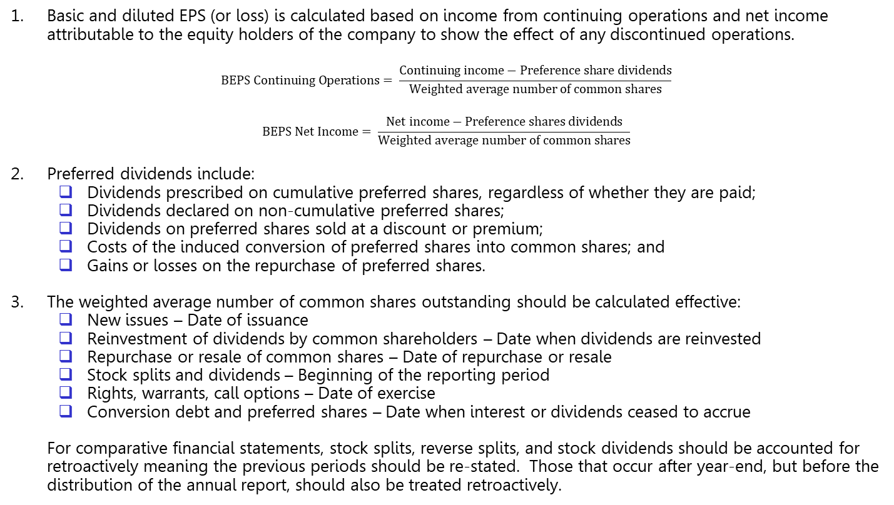
Earnings Per Share
1. Basic and diluted EPS (or loss) is calculated based on income from continuing operations and net income attributable to the equity holders of the company to show the effect of any discontinued operations.
$$BEPS Continuing Operations= \frac{Continuing income−Preference share dividends}{Weighted average number of common shares}$$
$$BEPS Net Income= \frac{Net income−Preference shares dividends}{Weighted average number of common shares}$$
2. Preferred dividends include:
  Dividends prescribed on cumulative preferred shares, regardless of whether they are paid;
  Dividends declared on non-cumulative preferred shares;
  Dividends on preferred shares sold at a discount or premium;
  Costs of the induced conversion of preferred shares into common shares; and
  Gains or losses on the repurchase of preferred shares.
3. The weighted average number of common shares outstanding should be calculated effective:
  New issues – Date of issuance
  Reinvestment of dividends by common shareholders – Date when dividends are reinvested
  Repurchase or resale of common shares – Date of repurchase or resale
  Stock splits and dividends – Beginning of the reporting period
  Rights, warrants, call options – Date of exercise
  Conversion debt and preferred shares – Date when interest or dividends ceased to accrue
For comparative financial statements, stock splits, reverse splits, and stock dividends should be accounted for retroactively meaning the previous periods should be re-stated. Those that occur after year-end, but before the distribution of the annual report, should also be treated retroactively.

Slide 10
Earnings Per Share
4. Diluted EPS shows the potential effect of all dilutive securities.
Rights, Warrants, and Options (Treasury Stock Method)
Assume all securities are exercised at the beginning of the reporting period or the date the securities were issued during the period.
Assume the proceeds from exercising these securities are used to purchase shares at the average price during the period.
Include the incremental shares in the denominator if positive, meaning the options are “in the money.”
Convertible Preferred Shares or Bonds (If Converted Method)
Assume the conversions take place at the beginning of the reporting period or the date the securities were issued during the period.
Add back after-tax interest expense and preferred share dividends.
Only include convertible securities that reduce Basic EPS based on continuing income beginning with the most separately dilutive security (i.e. anti-dilutive sequencing).

Slide 11
Interim Financial Reporting
Condensed interim reports
Condensed financial statements
Condensed explanatory notes
Condensed MD&A
Statement of financial position | End of the current interim financial period End of the preceding financial year
Statement of profit or loss and other comprehensive income | Interim financial period for the current financial year Comparable interim financial period for the preceding financial year Year-to-date period for the current financial year Comparable year-to-date period for the previous financial year
Statement of changes in equity | Year-to-date period for the current financial year Comparable year-to-date period for the preceding financial year
Statement of cash flows | Interim financial period for the current financial year Comparable interim financial period for the preceding financial year Year-to-date period for the current financial year Comparable year-to-date period for the preceding financial year

