Slide 1
Working Capital Management

Slide 2
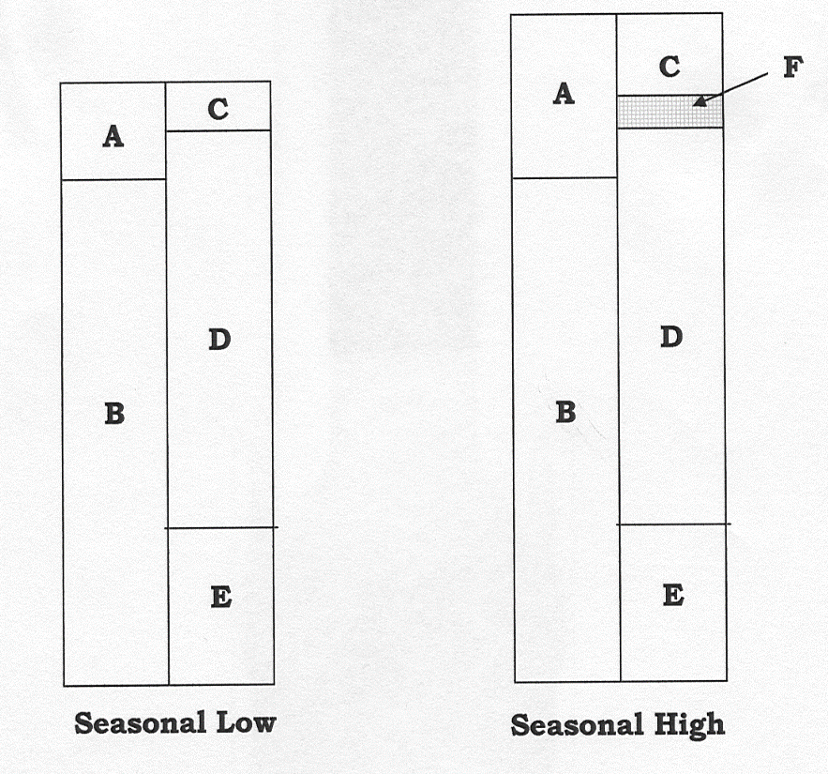
Maturity Matching Concept
A – Current Assets
B – Long-term Assets
C – Current Liabilities
D – Permanent Debt Financing
E – Permanent Equity Financing
A minus C – Net Working Capital (NWC)
F – Temporary Financing
“The line”

Slide 3
Managing Cash
Role of Cash
Transaction motive
Precautionary motive
Speculative motive
Payment Systems
Point-of-sale
Remote consumer transactions
Business transactions
Cash Management Practices
Electronic payment
Managing the float
Cash concentration

Slide 4
Investing Temporary Cash Surpluses
Why maintain a cash surplus?
Flexible maturity matching strategy
Accumulate cash for a major expenditures
Invest the proceeds of a stock or bond issue until the funds are needed
Establish a contingency fund
Effective Cash Management Tips
Pay down the LOC instead of investing
Pay suppliers early
Types of Investments
Treasury bills
Term deposits and CDs
Bearer deposit notes
Commercial paper, asset-backed commercial paper, sales finance paper, bankers’ acceptances
Short-dated bonds
Repurchase agreements
Euro deposits
Money market funds

Slide 5
Managing Accounts Receivable
Types of Credit
Open account
Installment credit
Revolving credit
Letters of credit
Length of Credit Terms
Credit Terms
Net 30
2/10, net 30
2/10, net 30 EOM
3/15, net 60, ROG
2/10, net 30, January 1
Cash terms
COD or CBD
Consignment
Bill-to-bill
Credit Approvals
Trade or consumer credit
Credit scores or ratings
Credit scoring models
5 Cs of credit assessment
  Character
  Capacity
  Capital
  Collateral
  Conditions
Collections
Credit Monitoring
Days of sales outstanding
Aging schedule

Slide 6
Managing Inventory
Inventory Management Techniques
Supply chain technology
ABC
EOQ, re-order points, safety stock
Materials resource planning
Just-in-time inventory and production
Vendor-managed inventory
Concurrent engineering
Outsourcing
Lean manufacturing
Key Performance Indicators
Days of inventory on hand
GMROI
Inventory accuracy
Order fill rate
Order filling accuracy
Order cycle time

Slide 7
Sources of Temporary Financing
Advantages
By-pass the middleman
Improved collateral
Credit enhancements
Other Sources
Specific assignment of accounts receivable
Specific assignment of inventory
Trust receipts
Warehouse financing
Public or terminal warehouses
Field warehouses
Purchase order financing
Factoring and reverse factoring
Securitization
Commercial paper
  Bankers’ acceptance
  Asset-backed commercial paper
Letters of credit

