Slide 1
Time Value of Money

Slide 2



Future Value and Compounding
Single Period
$FV=\left(P\right) \left(1+i\right)$ or$FV=\left(P\right)\left(1\right)+\left(P\right)\left(i\right)$
Multiple Periods
$$FV=\left(P\right) \left(1+i\right) \left(1+i\right) \left(1+i\right)$$
FV factor
$$FV= {\left(P\right)\left(1+i\right)}^{n}$$
Year | Beginning Principal (CAD) | Compound Interest i = 5.0% | Ending Principal (CAD)
1 | 1,000.00 | (1 + 0.05) = 1.05 | 1,050.00
2 | 1,050.00 | (1 + 0.05) = 1.05 | 1,102.50
3 | 1,102.50 | (1 + 0.05) = 1.05 | 1,157.63
FV factor = (1 + 0.05) (1 + 0.05) (1 + 0.05) = 1.15763

Slide 3
Simple Versus Compound Interest
Year | Simple Interest |  | Compound Interest
 | Beginning Principal (CAD) | Interest i = 5.0% | Beginning Principal (CAD) | Interest i = 5.0%
1 | 1,000.00 | 50.00 | 1,000.00 | 50.00
2 | 1,000.00 | 50.00 | 1,050.00 | 52.50
3 | 1,000.00 | 50.00 | 1,102.50 | 55.13
 | Total interest | 150.00 | Total interest | 157.63
Extra interest due to compounding = 157.63 -150.00 = CAD 7.63

Slide 4
“Magic” of Compound Interest

Slide 5
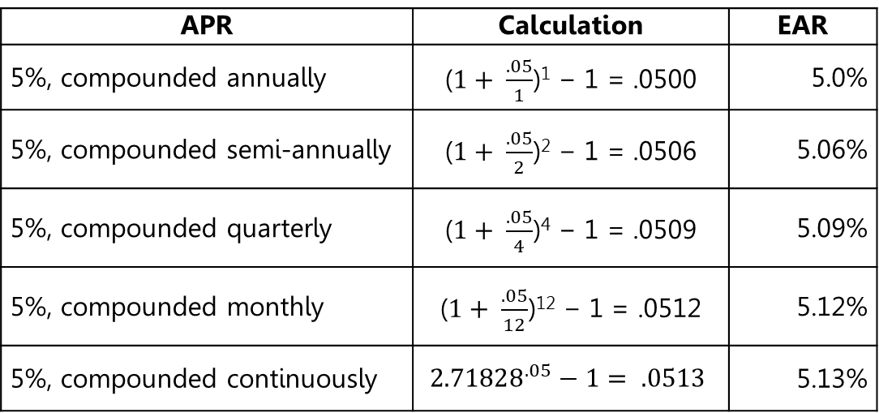
Annual Percentage Rate and Effective Annual Rate
$$EAR={\left(1+ \frac{APR}{Number of compounding periods per year}\right)}^{Number of compouding periods}$$
APR | Calculation | EAR
5%, compounded annually |  | 5.0%
5%, compounded semi-annually |  | 5.06%
5%, compounded quarterly |  | 5.09%
5%, compounded monthly |  | 5.12%
5%, compounded continuously |  | 5.13%

Slide 6
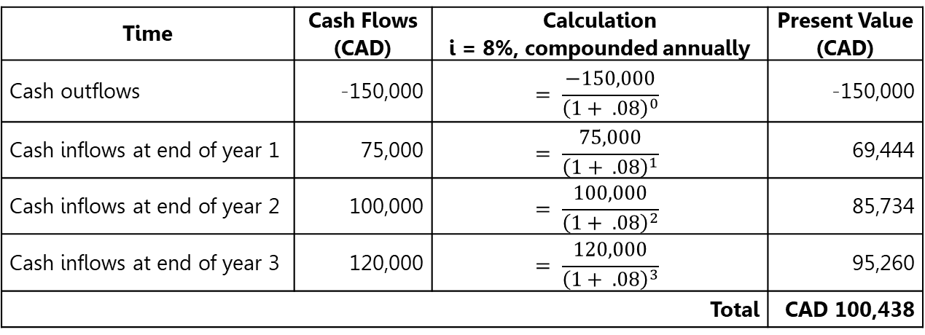
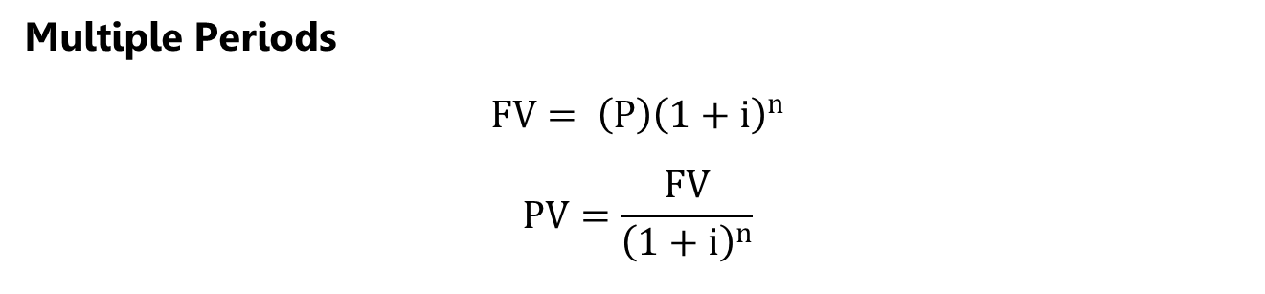
Present Value and Discounting
Multiple Periods
$$FV= {\left(P\right)\left(1+i\right)}^{n}$$
$$PV=\frac{FV}{{\left(1+i\right)}^{n}}$$
PV or discount factor
Time | Cash Flows (CAD) | Calculation i = 8%, compounded annually | Present Value (CAD)
Cash outflows | -150,000 | $$= \frac{−150,000}{{\left(1+ .08\right)}^{0}}$$ | -150,000
Cash inflows at end of year 1 | 75,000 | $$= \frac{75,000}{{\left(1+ .08\right)}^{1}}$$ | 69,444
Cash inflows at end of year 2 | 100,000 | $$= \frac{100,000}{{\left(1+ .08\right)}^{2}}$$ | 85,734
Cash inflows at end of year 3 | 120,000 | $$= \frac{120,000}{{\left(1+ .08\right)}^{3}}$$ | 95,260
Total |  |  | CAD 100,438

Slide 7
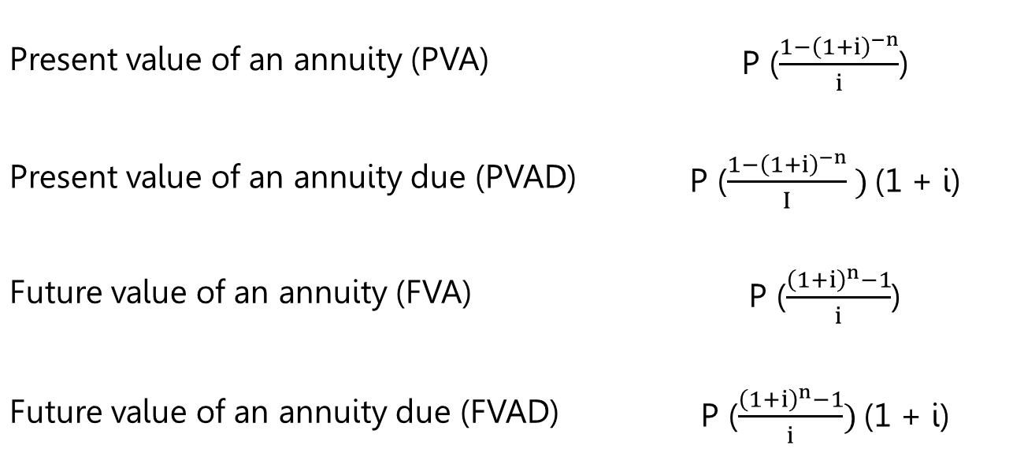
Annuity and Annuity Due
Present value of an annuity (PVA) | P ($\frac{{1−\left(1+i\right)}^{−n}}{i}$)
Present value of an annuity due (PVAD) | P ($\frac{{1−\left(1+i\right)}^{−n}}{I} )$(1 + i)
Future value of an annuity (FVA) | P ($\frac{{\left(1+i\right)}^{n}−1}{i}$)
Future value of an annuity due (FVAD) | P ($\frac{{\left(1+i\right)}^{n}−1}{i})$(1 + i)

Slide 8
Perpetuity
Present value of a perpetuity (PVP) | PVP = $\frac{P}{i}$

Slide 9
Growing Annuity and Perpetuity
Present value of an annuity with growth (PVAG) | $\left(\frac{P}{i − g}\right)$ (1 – ${\left(\frac{1+g}{1+i}\right)}^{n}$)
Present value of a perpetuity with growth (PVPG) | $\frac{P}{i – g}$

Slide 10
Commercial Lending
Discount loan
Interest-only (IO) loan
Amortized loan
Blended equal monthly payments
Straight line
Stepped repayment with a bullet option

Slide 11
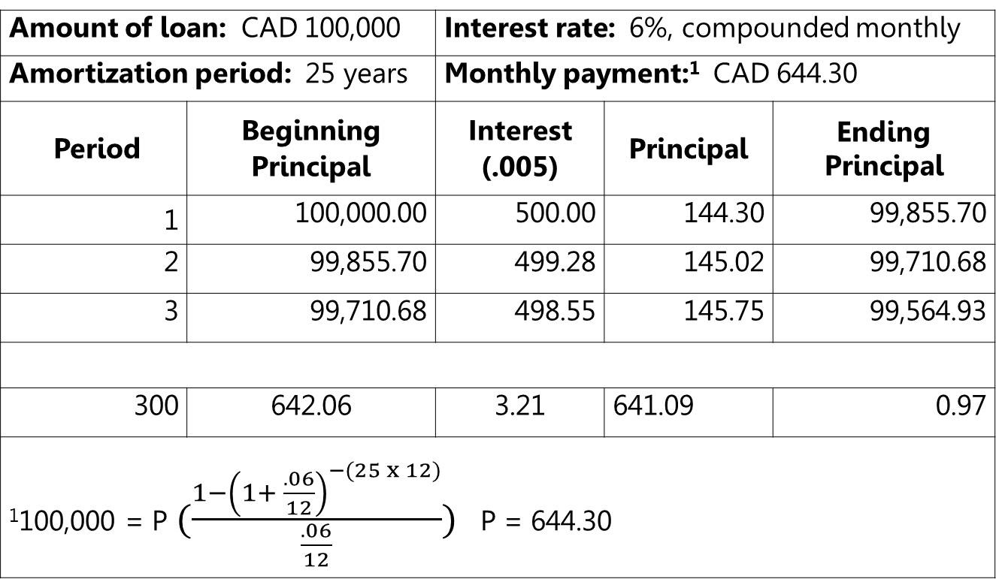
Amortization Table
Amount of loan: CAD 100,000 |  | Interest rate: 6%, compounded monthly
Amortization period: 25 years |  | Monthly payment:¹ CAD 644.30
Period | Beginning Principal | Interest (.005) | Principal | Ending Principal
1 | 100,000.00 | 500.00 | 144.30 | 99,855.70
2 | 99,855.70 | 499.28 | 145.02 | 99,710.68
3 | 99,710.68 | 498.55 | 145.75 | 99,564.93
300 | 642.06 | 3.21 | 641.09 | 0.97
¹100,000 = P$(\frac{{1−\left(1+ \frac{.06}{12}\right)}^{−(25 x 12)}}{\frac{.06}{12}})$ P = 644.30

Slide 12
Predefined FV and PV Functions in Excel
Predefined Functions
=FV (rate, nper, pmt, pv, type)
=PV (rate, nper, pmt, fv, type)
=RATE (nper, pmt, pv, fv, type)
=NPER (rate, pmt, pv, fv, type)
=EFFECT (nominal_rate, npery)
=NOMINAL (effect_rate, npery)
=PMT (rate, nper, pv, fv, type)
=IPMT (rate, per, nper, pv, fv, type)
=PPMT (rate, per, nper, pv, fv, type)

