Slide 1
Maturity Matching

Slide 2
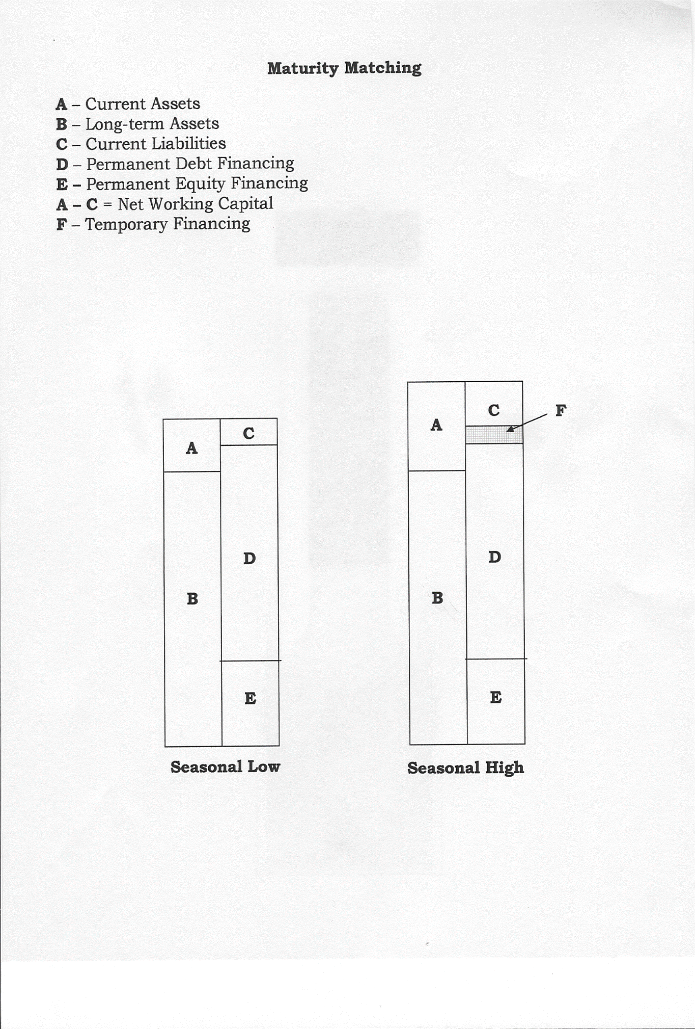
Maturity Matching Concept
A – Current assets
B – Long-term assets
C – Current liabilities
D – Permanent debt financing
E – Permanent equity financing
A minus C = Net working capital
F – Temporary financing
Seasonal Low
Seasonal High

Slide 3
Maturity Matching Concept
Why not “pull the line down” despite a lower interest cost and an easier loan application process?
  Rollover risk
  More variability of interest rates
Why not “push the line up” despite the lower rollover risk?
  Higher interest rate
  Funds cannot be repaid during the seasonal low
  An “annual cleanup” prevent companies from “pulling the line down” by requiring temporary financing to be paid down to zero at least once a year.

Slide 4
Maturity Matching Policies
Companies adopt different maturity matching policies which change over time and are influenced by the state of the economy, the nature of the business, its financial position, and management’s attitude towards risk.
Maturity matching policies can be classified as:
Restrictive
Flexible
Compromise
Maturity matching policies can also be classified as:
Neutral
Aggressive
Conservative

Slide 5
Maturity Matching Policies
Restrictive
Flexible
Temporary financing is used to finance the seasonal build-up in NWC.
Excess permanent financing is invested in cash and marketable securities during the seasonal low periods.
Asset Requirements
CAD
Permanent Financing
CAD
Permanent Financing
Asset Requirements
Time
Time
Compromise
A combination of temporary and permanent financing is used to fund the seasonal build-up in NWC.
Temporary Financing
CAD
Permanent Financing
Asset Requirements
Excess Permanent Financing
Time

Slide 6
Maturity Matching Policies
Assets | Long-term Assets | Long-term NWC |  | Variable NWC
Neutral policy | Permanent Financing |  |  | Temporary Financing
Aggressive policy | Permanent Financing |  | Temporary Financing
Conservative policy | Permanent Financing |  |  |  | Temporary Financing

Slide 7
Another Type of Rollover Risk
Companies allow the average maturity of their permanent financing to become significantly shorter than the average life of their long-term assets to benefit from lower interest rates.
There is a risk of not being able to rollover these loans due poor financial performance or a shortage of loanable funds.
Compare the average life of a company’s long-term assets to the average maturity of permanent financing to determine whether it is exposed to this other type of rollover risk.

Slide 8
Sources of Financing
Temporary Financing
Trade credit
Commercial line of credit
Permanent Financing
Mortgage loan
Term loan
Revolving credit facility
Loan Features
Purpose
Interest rate
Repayment
Stepped
Skipped
Seasonal
Balloon or bullet payments
Interest-Only
Straight-line
Prepayment
Collateral
Covenants
Guarantees

Slide 9
Problem: Term Loan with a Customized Repayment Schedule at Jenkins Company
 | Interest Paid (CAD) | Principal Paid (CAD) | Total (CAD)
September 30, 2016 | 12,500 | - | $12,500
December 31, 2016 | 12,500 | - | 12,500
March 31, 2017 | 12,500 | $50,000 | 62,500
June 30, 2017 | 11,250 | 50,000 | 61,250
September 30, 2017 | 10,000 | 50,000 | 60,000
December 31, 2017 | 8,750 | - | 8,750
March 31, 2018 | 8,750 | 50,000 | 58,750
June 30, 2018 | 7,500 | 50,000 | 57,500
September 30, 2018 | 6,250 | 50,000 | 56,250
December 31, 2018 | 5,000 | 200,000 | 205,000

